Slide 1

Detecting Outliers in IoT Data Streams
SystemX Seminar 14 March 2019
Vassilis Christophides
INRIA Paris (MiMove) vassilis.christophides@inria.fr
Mike Giannoulis & Theodoros Marios Giakoumakis
Computer Science Department, University of Crete
Notes:
The objective of this seminar is to highlight the importance of IoT data in the emerging Industry 4.0 and explain the need for processing and analyzing them in real-time. We then focus on state-of-the art algorithms for online unsupervised anomaly detection in IoT data streams.
This is an ongoing work, with
Part I: 9 slides
Part II: 16 slides
Part III: 22 slides

Slide 2

IoT Data Analytics
Disclaimer: The slides contain graphics & figures collected from the Web but hopefully cleverly edited, sequenced, and stitched for academic lecturing purposes

Slide 3

Universality of IoT Technology
Smart Transport & Logistics
Smart Energy
Smart Agriculture
Smart Buildings
Public Safety
Smart Homes & Cities
Smart Factories
Smart Health
Smart Retail
"From autonomous cars to intelligent personal assistants, data is the lifeblood of a rapidly growing digital existence – opening up opportunities previously unimagined by businesses“ IDC
Notes:
The IoT is rapidly transforming the physical world into a large scale information system!
There are many areas where Internet of Things (IoT) has already become reality: Intelligent street lights, smart meters and self-farmed fields to name a few. Devices can decide when to power up, when to buy energy because it is cheap, and when to start watering a field. Decisions based on data, not just pre-programmed activation. There are even more: Wearables that predict an upcoming disease, or electronics that notify customer service themselves if there is a problem.

Slide 4
Digital Transformation of the Physical World
Industry | Past: Shelling a Product | Future: a Service
Energy & utilities | Power networks/grids | On demand energy production/ consumption
Automotive | Cars | Transportation (assisted, autonomous driving)
Agriculture | Seeds | Crop Yields
Healthcare | Diabetes pumps | Diabetes cares
Food | Packaged goods | Nutrition
Cities | Physical Urban infrastructure / Facilities | Smart city e-services (street lighting, urban noise/pollution/ traffic monitoring, parking/waste management etc.)
…. | …. | ….
IT Industry | Computers | Computation
McKinsey, GE, IBM, Cisco et al. estimate hundreds of billions dollar savings/efficiency improvements in the next 10 years
Notes:
https://en.wikipedia.org/wiki/Crop_yield
In agriculture, crop yield (also known as "agricultural output") refers to both the measure of the yield of a crop per unit area of land cultivation, and the seed generation of the plant itself (e.g. if three grains are harvested for each grain seeded, the resulting yield is 1:3).
Σύμφωνα με το Παγκόσμιο Ινστιτούτο McKinsey, σε σύγκριση με τη Βιομηχανική Επανάσταση στα τέλη του 18ου αιώνα, οι αλλαγές που επιφέρει η τεχνητή νοημοσύνη στην κοινωνία συμβαίνουν 10 φορές πιο γρήγορα και θα έχουν 300 φορές μεγαλύτερο αντίκτυπο. Αυτό που συμβαίνει και θα συμβεί τα επόμενα χρόνια δε θα μοιάζει με τίποτα από όσα έχουμε δει ως τώρα στην ανθρώπινη ιστορία.
https://www.huffingtonpost.gr/entry/technete-noemosene-kai-aetomatismos-e-meyale-serriknose-tes-mesaias-taxes_gr_5aeada26e4b00f70f0ef90b9?utm_hp_ref=gr-blogs

Slide 5
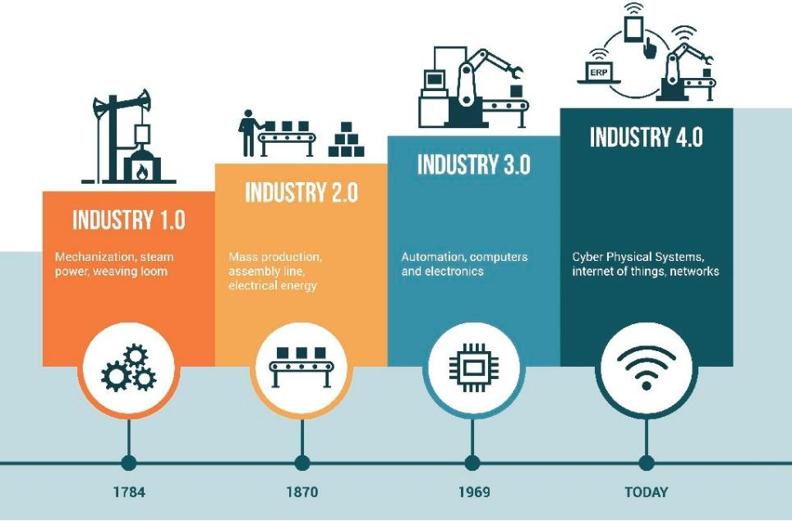
The Four Industrial Revolutions
Characteristics of IoT
Hyper-connectivity
Ultra-wide area
Domain expandability
Self-configuration & maintenance
Everybody & everything is networked –networked information as a “huge brain”
Digital computing & communication technology, enhancing systems’ intelligence
Centralized electric power infrastructure; mass production by division of labor
Mechanical production using the power of water and steam
End of 18th century
Beginning of 20th century
Mid of 20th century
Henning Kagermann et.al., Recommendations for implementing the strategic initiative Industrie 4.0 Acatech, 2013
Notes:
In general, the Internet of Things (IoT) is the network that connects people, data, processes, and physical objects including machines, devices, and appliances. This hyper-connectivity has been delivering new capabilities, richer experiences, and unprecedented economic opportunity for businesses, individuals, and cities.
“The first three industrial revolutions came about as a result of mechanization, electricity and IT. The introduction of the Internet of Things is ushering in a fourth industrial revolution. … Industry 4.0 will address and solve some of the challenges facing the world today such as resource and energy efficiency, urban production and demographic change. ” Henning Kagermann et.al., Recommendations for implementing the strategic initiative Industrie 4.0 Acatech, 2013
“Look at the list of the Fortune 500 companies from 10 years ago. Today, 35 percent of them are no longer in it.” Vishal Sikka, CEO, InfoSys

Slide 6


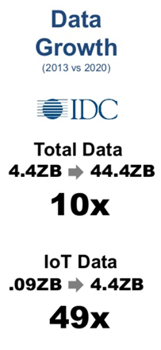

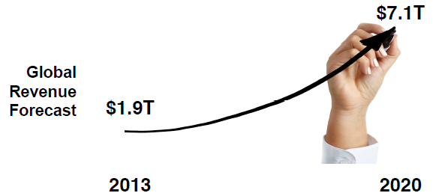


Massive Size and Growth of IoT
10²¹
EMC IDC digital universe of opportunities
By 2025, about 25% of all data will be real time in nature out of which 95% of it will be generated by IoT!
https://www.slideshare.net/IoTBruce/iot-meets-big-data-the-opportunities-and-challenges-by-syed-hoda-of-parstream
Notes:
IDC expects the average connected person to somehow interact with a connected device every 18 seconds, or nearly 4,800 times each day, by 2025. And those interactions, many of which occur in the background with little to no deliberate prompting on behalf of users, will flood enterprises with data.
Cisco's fourth annual Global Cloud Index study (https://www.cisco.com/c/en/us/solutions/collateral/service-provider/global-cloud-index-gci/white-paper-c11-738085.html) shows that data from devices connected to the internet will reach 4.03ZB a year by 2018, up from 113.4ZB a year in 2023. A zettabyte is a trillion gigabytes. Cisco cited several business examples that will drive this huge rise in data, such as a Boeing 787 aircraft, which generates 40TB per hour of flight, or a Rio Tinto mining operation that can generate up to 2.4TB of data a minute. Despite this huge growth in data from IoT devices, only a small amount will actually be sent to data centers for storage and subsequent analysis.
A 2017 IDC white paper (https://www.seagate.com/files/www-content/our-story/trends/files/Seagate-WP-DataAge2025-March-2017.pdf) forecasts that by 2025, the world will generate 160 zettabytes of data, up from 16 zettabytes today. The report all notes that by 2025, about 25% of all data will be real time in nature. Of this 25%, 95% of it will be generated by IoT.
https://www.v3.co.uk/v3-uk/news/2379626/internet-of-things-to-generate-400-zettabytes-of-data-by-2018
https://www.mckinsey.com/industries/semiconductors/our-insights/whats-new-with-the-internet-of-things

Slide 7



IoT Data Sources
Passive Sources: These are sensors that must be activated before they can transmit data, and they only produce data when asked to do so
  For example, a sensor that measures ground water saturation only produces data when the API is invoked, thus sensors are managed by the IoT app
Active Sources: Unlike passive things, these devices constantly toss off data in a streaming fashion
  IoT app needs to ingest the data in near real-time, and the time interval between subsequent data carries valuable information about the dynamics of the monitored physical or mechanical system
Dynamic Sources: These are devices with sensors that communicate dynamically (bidirectional) with IoT apps
  These types of sensors carry out a conversation with IoT apps
pull
push
interactive
https://www.rtinsights.com/three-types-of-iot-data-sources/
Notes:
It’s time we look at the emerging patterns of IoT, which will provide better opportunities to define and solve problems. These patterns surround the use of data, which is the real core of IoT.
Passive data does not mean a passive data/IoT application. Indeed, since the sensors need to be managed, the application must take on the logic needed to do so. These are typically sensors that are low power and exist in remote locations.
This allows a full range of capabilities, including the ability to change the data that’s produced, change the format of the data, change the frequency, and even deal with security issues and provide automated software updates to dynamically deal with issues. In short, data from dynamic is like an IoT application talking to another application. They do not just deal with data points that devices produce, but can alter the data produced to meet the needs of the target IoT application. These are also self- and auto-configurable, and these dynamic capabilities really provide the best IoT capabilities.
As you build IoT applications, you’ll find that the types of IoT data—passive, active, or dynamic— will be mixed into most IoT systems. However, as time moves on, and we build net-new IoT systems, the data from dynamic will be the most likely evolution. This is due to the capabilities of these sensors, specifically the automation that makes them less likely to be obsolete anytime soon.

Slide 8
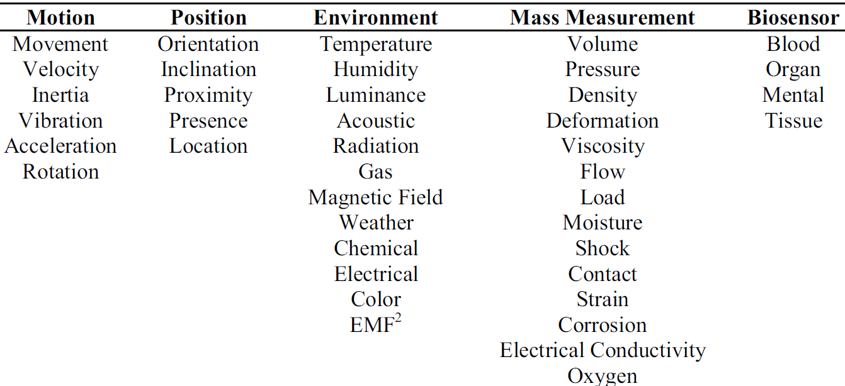
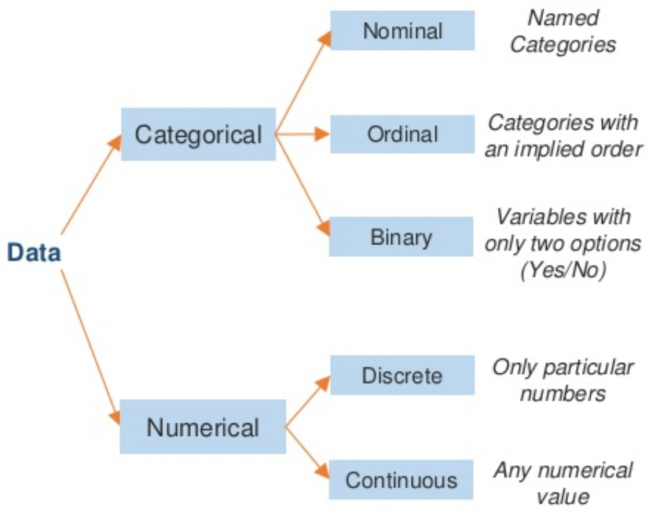
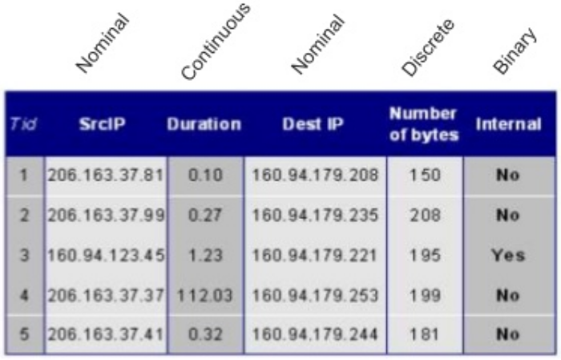
Types of IoT Data
Addresses/Unique Identifiers (nominal)
  IP (IPv4, IPv6), Bluetooth, Zigbee, LoRa, RFID
Positional Data (continuous)
  GPS (Longitude, Latitude, Altitude), WiFi (Longitude, Latitude)
Temporal Data (continuous)
  Time and Date
Sensor Data (numerical)
  Output of a device that detects and responds to some type of input from the physical environment (motion, position, environment, mass, biomarker)
Descriptive Data (categorical)
  Objects, Processes, and Systems
Notes:
Datatypes of Mixed, Categorical and Numerical are used. Categorical data consists of nominal and ordinal data. Numerical data consists of Real, Continuous and Discrete data.

Slide 9
IoT Data: Sensing the Physical World!
IoT data is becoming soon “mega” big (i.e. billions of connected Things)
  44EB / months corresponds to ~ 100M hard disks
  Processing 44 EB with 100M servers would still take > one hour
10¹⁸
IoT “data in motion” as opposed to traditional “data at rest”
  Data speed is bound by the sensing frequency and connectivity
  Data throughput (vs processing) has become the limiting factor!
High variety data e.g., from heterogeneous Things, embedded in the environment or wearable by persons
High veracity data (dropped or unlivable) as IoT data quality depends on how Things are used and connected in the wild
High variability data as Things frequently change behavior dynamically and in ways that are not fully known in advance
Data security, privacy, etc. even more important!
Notes:
E.g., pressure sensor data from a pipeline system, acoustic sensor data sensors from an engine, vibration sensor data on a suspension bridge
Data bias: As in the majority of data mining problems, IoT datasets can lead to biased processing and hence a thorough understanding and scrutiny of both training and test datasets is required prior to their operationalized deployment. To this end, classical data mining techniques can also be applied in the case of IoT applications.
https://www.linkedin.com/pulse/iot-tutorial-chapter7-data-iot-bigdata-convergence-john-soldatos/

Slide 10

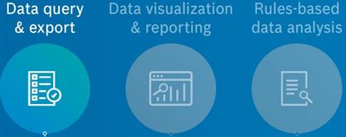


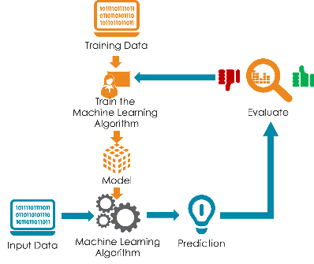
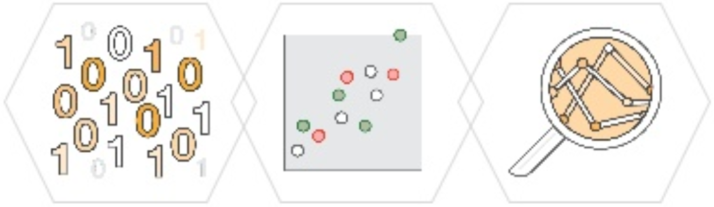

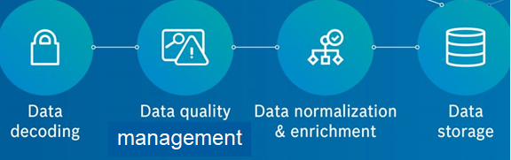
IoT Data Life Cycle
Data Ingestion & Processing
Data Analytics & Visualization
Data Transmission
How to engender trust in the processes that use/consume the data?
IOT Data Preparation Pipelines
Data Decoding
Data Cleaning
Data Contextualization
  The importance of reliability of data is even higher when exploited in applications which involve or affect human lives!
https://blog.bosch-si.com/internetofthings/the-top-4-benefits-of-iot-data-management/
Notes:
Data collection
Data validation
Data semantic unification and interoperability
Data structuring and Storage
Data analysis
Real-time outputs -visualization/actionable feedback

Slide 11
IoT Data Analytics
Use Cases
  Real-time monitoring and control
  Failure detection and predictive maintenance
  Malicious cyber activity detection
  Product life-cycle management
  Operational efficiency, optimization, self-adaptation
Batch and Online Techniques
  Descriptive Analytics: aggregation and statistics
  Predictive Analytics: Supervised, Semi-Supervised, Unsupervised
  Data series analytics: Spatiotemporal
  Domain and data type specific: Signal processing
Anomaly Detection
Notes:
Although it has been studied in detail in academia, applications of anomaly detection have been limited to niche domains like banks, financial institutions, auditing, and medical diagnosis etc. However, with the advent of IoT, anomaly detection would likely to play a key role in IoT use cases such as monitoring predictive maintenance and cyber security.

Slide 12
Real Time Anomaly Detection
Monitor Traffic Conditions
Monitor Biomarkers
Predictive maintenance, Production safety Monitoring
Agriculture
Pest, Water Control
Network and Cyber Security
Detect Intrusion
Monitor Energy Consumption
Define alerts, predict faults, detect intrusions & threats
Notes:
Measurement data streams: monitor evolution of entity states
Time value of sensor data means that the data you have right now won’t mean as much a week, day or even hour from now !

Slide 13






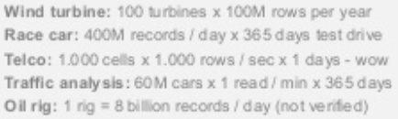
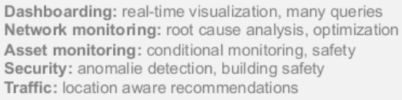
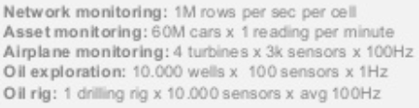

What Makes IoT Data Processing & Analytics Challenging?
10B+ rows
<1 sec response time
continuous data from multiple things in the wild
ingest and process data series
use multiple data analytics methods
data analytics distributed in several locations
integration with business operation systems
bidirectional communication and control of endpoints
1M+ rows/sec
100+ locations
High Volumes of Raw data in Motion
Complex Data Processing & Analytics Pipelines
Real-time Control and Automation
Adapted from https://www.gartner.com/smarterwithgartner/ transform-your-business-with-iot-analytics/
Notes:
https://www.rtinsights.com/iot-analytics-data-integration-and-business-intelligence/
Traditionally businesses would use end-of-the-day reports and relied heavily on Excel spreadsheets to optimize operations. Organizations started moving to data warehouse models in the 1990s, but data analysis often took hours or days. Today it is possible to connect business processes and systems to the internet, such as for enterprise resource planning and customer relationship management. And through the explosion of machine sensors and networks, it is now possible to connect point-of-sale systems, manufacturing equipment, or devices used in smart homes and buildings. Gartner, in fact, predicts that more than half of major new business processes and systems will incorporate some element of the IoT by 2020. Use cases enabled by the IoT are extensive:
When point-of-sale data is combined with manufacturing and warehouse data, a retailer can optimize their supply chain to increase sales and ensure a smooth customer experience.
A manufacturer could predict when a piece of equipment might fail, or spot defects on a production line, saving millions of dollars;
A smart building might continually adjust the temperature in certain rooms, solar output, or lighting, leading to substantial energy savings;
A transportation or shipping system could reroute during times of congestion, thus improving customer experience and gaining insights on future planning.

Slide 14
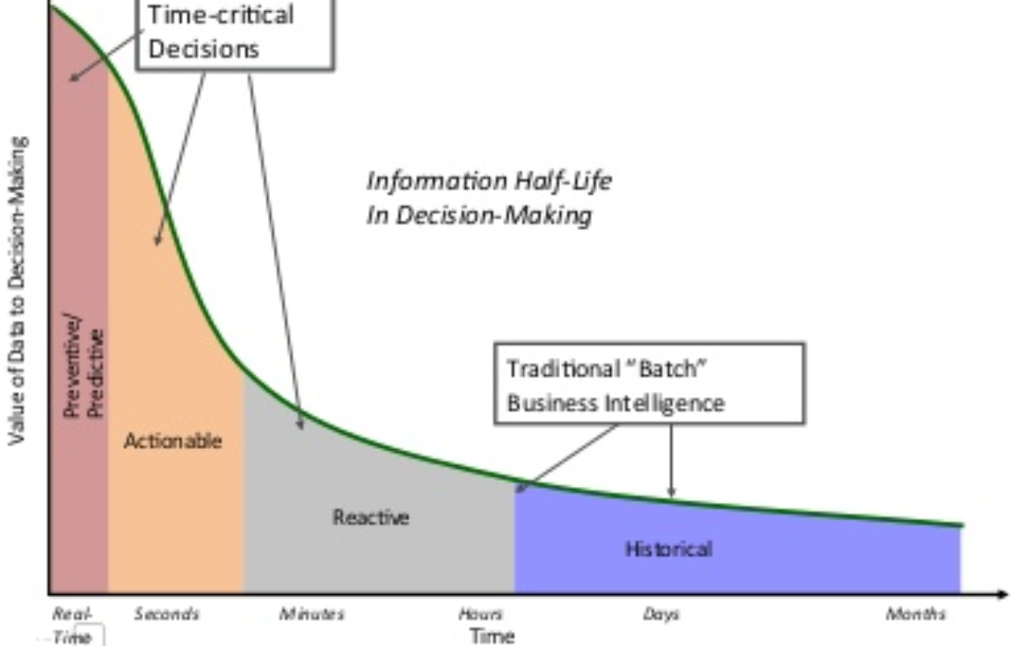
What is Real Time Analytics?
Time value of sensor data means that the data you have right now won’t mean as much a week, day or even hour from now !
near real time
medium-term
long-term
historical
https://www.slideshare.net/AmazonWebServices/introduction-to-realtime-streaming-data-and-amazon-kinesis-streaming-data-ingestion-with-firehouse
Notes:
An increasing amount of data is priceless in the seconds after it’s collected — consider the instance of a hacker accessing accounts — but it loses all value during the time it takes to move it to the centralized data center infrastructure or upload it to the cloud.
IoT data has distinct life stages:
near real time (1 second-1 minute),
medium-term (1-30 minutes),
long-term (30 minutes-1 day),
historical (1 day+)

Slide 15

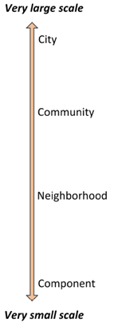
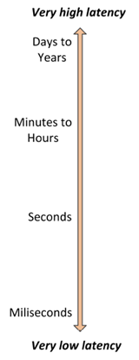
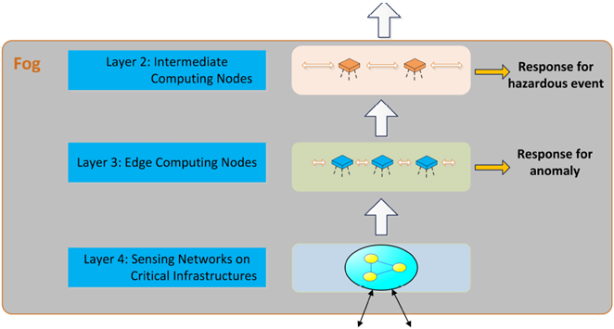
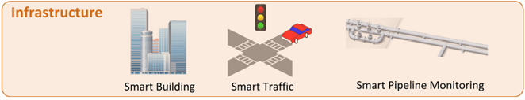
A Fog/Edge Computing Architecture
large compute storage
offline
larger compute limited storage
online
limited compute storage
real time
B. Tang, Z. Chen, G. Hefferman, T. Wei, H. He, Q. Yang. A Hierarchical Distributed Fog Computing Architecture for Big Data Analysis in Smart Cities. ASE BD&SI 2015
Notes:
Fog nodes extend the Cloud; bring it closer to the connected device sending/receiving data
Fog sits between the edge devices and the Cloud
Fog node –any device with compute processor, small storage, NW connectivity
Edge analytics can be done on Fog nodes
Fog Computing -reduces latency, increases speed to react to incoming data from edge devices.

Slide 16
So to Recap
The Internet of Things Is more About Data, than Things!
  data in motion usually with spatiotemporal semantics
  produced by several, distributed, heterogeneous devices
  in the wild, hence data prone to errors and noise
Low-latency, privacy-aware IoT data processing in post-cloud architectures
  Edge/fog computing for effectively and efficiently ingesting and analyzing data when and where it is needed
Real time IoT Data Analytics requires data streams support
  Limited ground truth calls for unsupervised techniques
Notes:
(e.g., real-time monitoring and control, correct malfunctions, detect security breaches, etc.)
data about people (in the consumer IoT), thus data security, privacy, etc. even more important !
the size of ML models should be small enough to be used in edge devices and should also have a short inference time for real-time use

Slide 17

Data Anomaly Detection

Slide 18
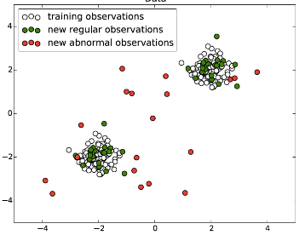
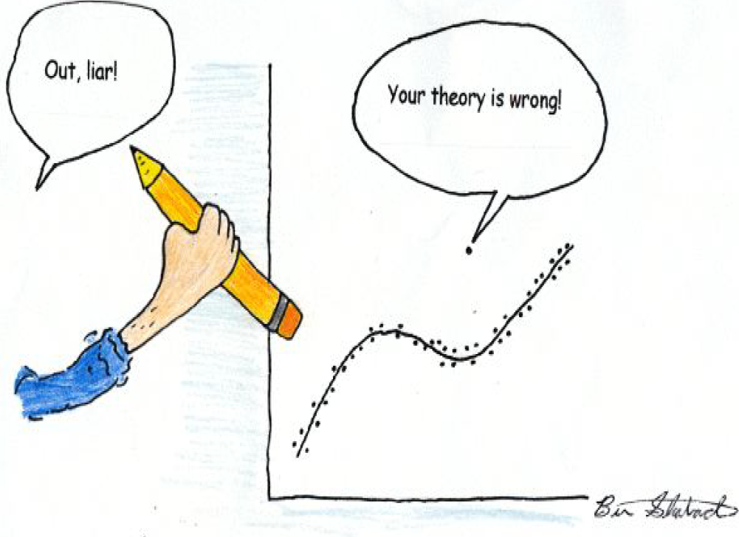
Data Anomalies
What are anomalies?
  “An outlier is an observation in a dataset that appears to be inconsistent with the remainder of that dataset” [Johnson 1992]
  “An outlier is an observation that deviates so much from other observations as to arouse suspicion that it was generated by a different mechanism” [Hawkins 1980]
Anomaly, or outlier, or deviation, or novelty detection, aims to measure whether a data point (or a subset) considerably differs than the remainder of the data points
  On a scatter plot of the data, they lie far away from other data
  Anomalies = Outliers + Novelties
http://www.kdd.org/kdd2016/topics/view/outlier-and-anomaly-detection
Notes:
Anomalies are the unusual, unexpected, surprising patterns in the observed world. Identifying, understanding, and predicting anomalies from data form one of the key pillars of modern data mining. Effective detection of anomalies allows extracting critical information from data which can then be used for a variety of applications, such as to stop malicious intruders, detect and repair faults in complex systems, and better understand the behavior of natural, social, and engineered systems.
Anomaly detection refers to the problem of finding anomalies in data. While anomaly is a generally accepted term, other synonyms, such as outliers, discordant observations, exceptions, aberrations, surprises, peculiarities or contaminants, are often used in different application domains. In particular, anomalies and outliers are often used interchangeably.

Slide 19

Cause of Data Anomalies
Errors in the data collection or measurement process
  Because of human error (intentional or not), a problem with a measuring device or the presence of noise
  Insights extracted from “dirty data” are probably erroneous and thus the decisions to be made are likely unsound (e.g., incur a high rate of false positives and false negatives)
Changes in the “data generation” process, e.g. some given statistical process (not an error, novelties in data)
  Abnormal data deviate from this generating mechanism because it is of a different type
  Novel class of observations provide valuable insights
Notes:
In the process of producing, collecting, processing and analyzing data, outliers can come from many sources and hide in many dimensions. Those that are not a product of an error are called novelties.
Novelty detection aims to detect unobserved (emergent) patterns in data
A novelty can be considered as a specific type of anomaly that occur after the training phase has been completed. The rationale is that a novelty does not fit well to the previously learned distributions.
Underlying statistical assumption: the data constitute a random sample from a population and they can be represented as points in a vector space of random variables

Slide 20
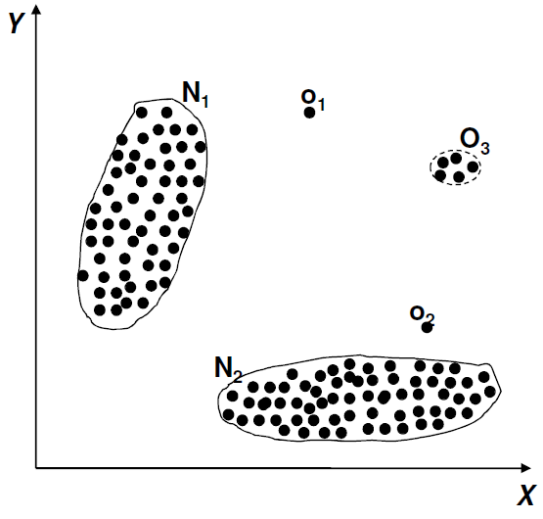
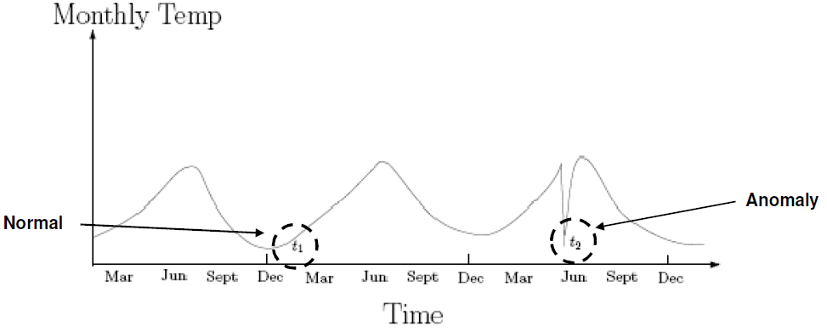
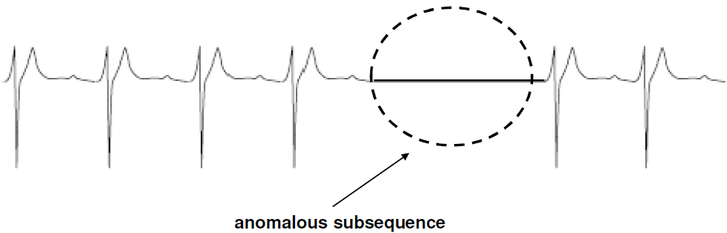
Types of Anomalies
Point Anomaly Detection
Data point anomalous w.r.t. to the rest of the data
Data point anomalous in a specific context; also referred to as conditional anomalies
Requires a notion of context
  the spatial or temporal neighborhood
Contextual Anomaly Detection
A group of data points is anomalous; the individual points within a group are not anomalous by themselves
Requires a relationship among data instances
  Sequential data
  Spatial data
  Graph data
that is, a single object is unsuspicious while a collection of similar objects becomes spurious
Group Anomaly Detection
Chandola, V., Banerjee, A., & Kumar, V. (2009). Anomaly detection: A survey. ACM Computing Surveys, 41(3), 1–58.
Notes:
K. Muandet, B. Schölkopf, "One-class support measure machines for group anomaly dection", Proc. Conf. Uncertain. Artif. Intell., pp. 449-458, Mar. 2013.

Slide 21
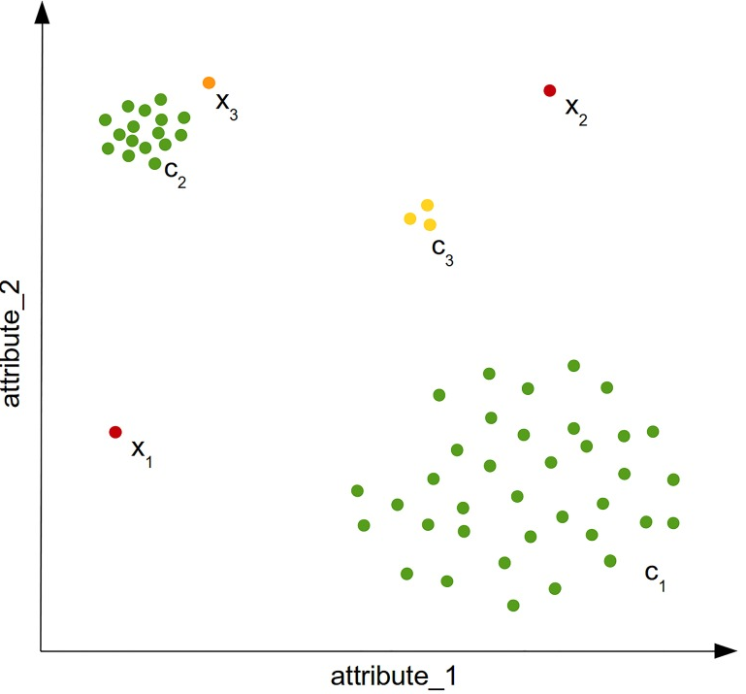
Scope of Anomaly Detection Methods
local
global
o₁
o₃
N₁
micro-cluster
O₄
global
o₂
N₂
Swamping: wrongly identifying normal instances as anomalies when normal instances are too close to anomalies
Masking : an anomaly is close to another point, anomalous or not
false positives
false negatives
M. Goldstein, S. UchidaA Comparative Evaluation of Unsupervised Anomaly Detection Algorithms for Multivariate Data. PLoS One. 2016;11(4)
Notes:
Two anomalies can be easily identified by eye: x1 and x2 are very different from the dense areas with respect to their features and are therefore called global anomalies. When looking at the dataset globally, x3 can be seen as a normal record since it is not too far away from the cluster c2. However, when we focus only on the cluster c2 and compare it with x3 while neglecting all the other instances, it can be seen as an anomaly. Therefore, x3 is called a local anomaly, since it is only anomalous when compared with its close-by neighborhood. It depends on the application, whether local anomalies are of interest or not. Another interesting question is whether the instances of the cluster c3 should be seen as three anomalies or as a (small) regular cluster. These phenomena is called micro cluster and anomaly detection algorithms should assign scores to its members larger than the normal instances, but smaller values than the obvious anomalies. This simple example already illustrates that anomalies are not always obvious and a score is much more useful than a binary label assignment.
The distinction between global and local outliers (and correspondingly, between global and local outlier detection methods [Breunig, M. M., Kriegel, H. P., Ng, R. T., & Sander, J. (2000). LOF: Identifying density-based local outliers. In Proceedings of the ACM International Conference on Management of Data (SIGMOD) (pp. 93–104). Dallas, TX.] refers to the scope of a database being considered when a method decides on the “outlierness” of a given object. While some methods take always the complete database into account, others consider only a local selection of database objects, for example, the k nearest neighbors of a point. [Schubert, E., Zimek, A., & Kriegel, H. P. (2014b). Local outlier detection reconsidered: A generalized view on locality with applications to spatial, video, and network outlier detection. Data Mining and Knowledge Discovery, 28(1), 190–237.] discussed the aspect of locality in outlier detection in depth.

Slide 22

Example: Most Unusual Objects?
screw
battery
bead
block
box
key
penny
knob
dime
eraser
https://www.slideshare.net/mlvlc/l14-anomaly-detection
Notes:
10 objects
penny centime
dime dixième de dollar
knob bouton
eraser gomme
box boîte
block bloc
screw vis
battery batterie
key clé
bead perles

Slide 23
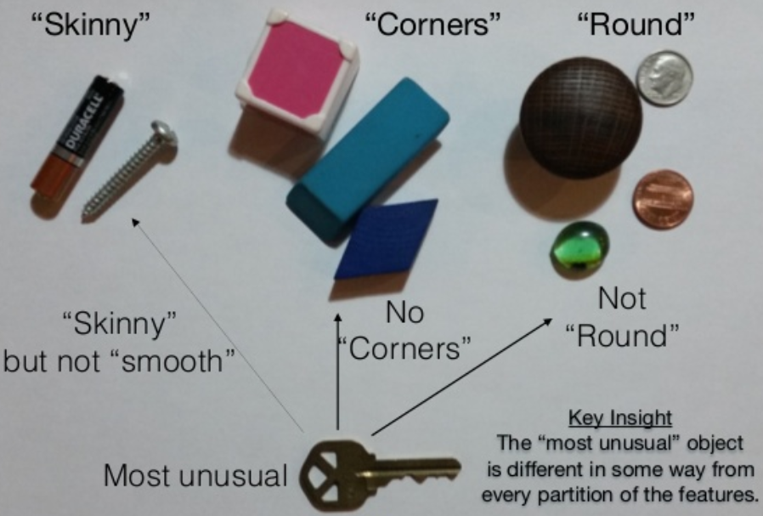
Example: How to Distinguish Objects?
https://www.slideshare.net/mlvlc/l14-anomaly-detection
Notes:
Humans used prior knowledge to select features that separated objects
“skinny”, “corners”, “round”, “smooth”
Objects have been separated based on the chosen features
Each cluster has been examined to see
which object fits less well in its cluster
and did not fit any other cluster

Slide 24
Example: How to Distinguish Objects?
Humans used prior knowledge to select features that separated objects
  “skinny”, “corners”, “round”, “smooth”
Objects have been separated based on the chosen features
Each cluster has been examined to see
  which object fits less well in its cluster
  and did not fit any other cluster
Learning from humans: create features that capture object differences
  Length/width:
    >=1 =>“skinny”
    ==1 =>”round”
    <1 => “tinny“
  Number of surfaces:
    distinct surfaces requires “edges” that have corners
  Smooth: true or false
https://www.slideshare.net/mlvlc/l14-anomaly-detection

Slide 25
High-Dimensional Data: Example
Object | Length/Width | Num Surfaces | Smooth
penny | 1 | 3 | true
dime | 1 | 3 | true
knob | 1 | 4 | true
box | 1 | 6 | true
eraser | 2.75 | 6 | true
block | 1.6 | 6 | true
screw | 8 | 3 | false
battery | 5 | 3 | true
key | 4.25 | 3 | false
bead | 1 | 2 | true
round
skinny
https://www.slideshare.net/mlvlc/l14-anomaly-detection
Notes:
Learning from humans: create features that capture object differences
Length/width:
>=1 =>“skinny”
==1 =>”round”
<1 => “tinny“
Number of surfaces:
distinct surfaces requires “edges” that have corners
Smooth: true or false
Looking at features individually, sometimes none of them may reveal any anomalous behavior. Capturing numerous features is desirable since certain random fluctuations, i.e., anomalous behaviour, can only be observed if studying high dimensions.

Slide 26
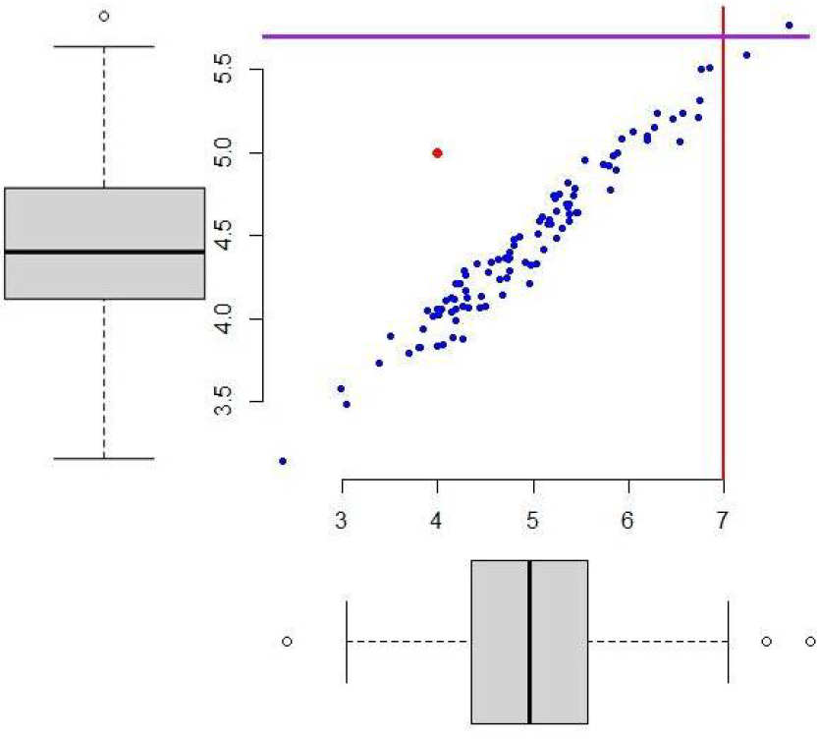
Multi-Dimensional Anomaly Detection
Anomaly detection in multi-dimensional datasets reveals more accurate behavior of the data but at the same time poses various challenges
http://wikistat.fr/pdf/st-m-app-anomalies.pdf
Notes:
une anomalie détectée simultanément par les diagrammes en boîte unidimensionels semble moins atypique que celle en rouge au regard de la distribution bidimensionnelle.

Slide 27
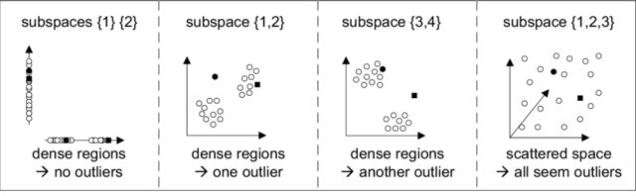
Multi-Dimensional Anomaly Detection
  Space concentration of distances: feature-wise distances of i.i.d. data samples approximately converge to a normal distribution
  The number of feature subspaces grows exponentially with the increasing dimensionality of data: data density functions not easily computed
  Data-snooping bias: given enough features, at least one feature subspace can be found for each data point such that it appears as an anomaly
D. L. Donoho, “High-dimensional data analysis: The curses and blessings of dimensionality,” AMS Math Challenges Lecture, pp. 1–32, 2000.
Notes:
, due to the central limit theorem,
Distance metrics (Euclidean, Manhattan, etc. [D. Ashlock, Evolutionary Computation for Modeling and Optimization. Springer, 2010.]) cannot measure the similarity between data points if the number of dimensions is large [K. S. Beyer, J. Goldstein, R. Ramakrishnan, and U. Shaft, “When is “nearest neighbor” meaningful?” ser. ICDT ’99.]
Data density functions (DDF) summarizing the normal behavior of the data points cannot easily computed because the DDF space grows exponentially with the number of dimensions

Slide 28
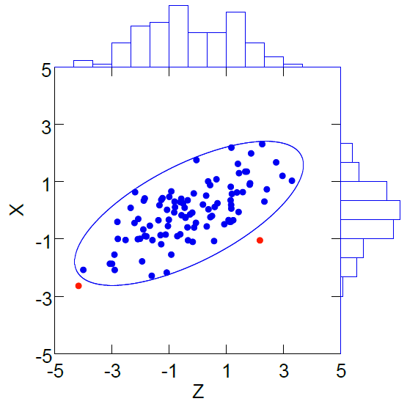
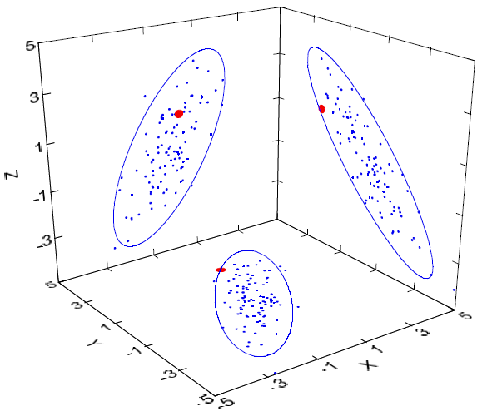
Multi-Dimensional Anomaly Detection
Challenge: select a subspace that highlights relevant features, i.e. in which anomalies exhibit significantly different values from normal data
  A robust anomaly detector should be able to detect anomalies with a high proportion of irrelevant features creating noise in the input data, which masks the true anomalies
L. Wilkinson Visualizing Big Data Outliers through Distributed Aggregation IEEE Trans. Vis. Comput. Graph. 24(1):Jan. 2018.
Notes:
In the above Figure the data are samples from a multivariate Normal distribution. The left panel plot illustrates the problem of detecting outliers in low-dimensional projections for two dimensions. The figure incorporates a 95 percent joint confidence ellipse based on the sample distribution of points. Two points are outside this ellipse. The red point on the left is at the extreme of both marginal histograms. But the one on the right is well inside both histograms. Examining the separate histograms would fail to identify that point. The right panel plot shows the situation for three dimensions. The three marginal 2D plots are shown as projections onto the facets of the 3D cube. Each confidence ellipse is based on the pairwise plots. The
red outlying point in the joint distribution is inside all three marginal ellipses. The 2D scatterplots fail to reveal the 3D outlier. The situation gets even worse in higher dimensions.
Relevant features for detecting an anomaly are those that exhibit significantly different values from those in normal instances. In other words, anomalies can only be detected in a feature subspace, and they do not look anomalous outside that subspace. The ability to detect anomalies in data sets with irrelevant features is an essential feature for a state-of-the-art anomaly detector.
In addition, it is desirable that the algorithm be efficient in terms of time complexity, memory complexity and the required number of labelled records.

Slide 29
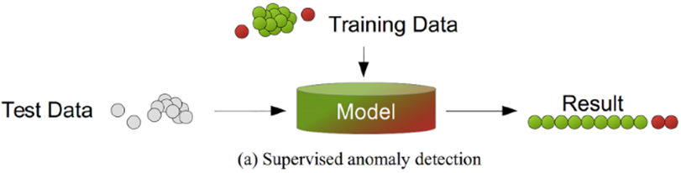
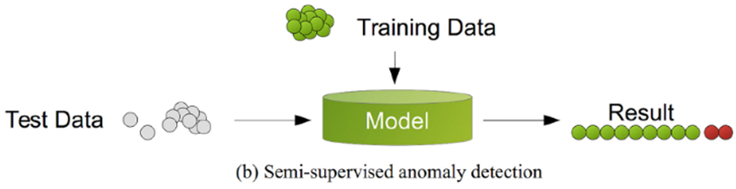
Anomaly Detection Methods
New anomalies will be “similar” to some past anomaly
Labels available for both normal data and anomalies
Rare Class Mining
classification with high class imbalance
Labels available only for normal data, test data may contain unknown anomalies
Anomalies are “rare” in the reference dataset, and i.i.d.
One Class
Unknown labels for both normal data and anomalies
Outliers are ”rare” and ”isolated” w.r.t. inliers
Nearest Neighbor based (distance, density) Clustering based
Goldstein M, Uchida S (2016) A Comparative Evaluation of Unsupervised Anomaly Detection Algorithms for Multivariate Data. PLOS ONE 11(4)
Notes:
Anomaly detection approaches can be classified into 3 categories: supervised, semisupervised, and unsupervised. Supervised approaches are dependent on labeled data, semisupervised approaches allow the use of unlabeled data together with labeled data, and unsupervised approaches are not dependent on labeled data at all. Due to the high cost associated with labeled data, unsupervised approaches have been given substantial attention in recent literature.

Slide 30
Anomaly Detection Methods
Machine Learning
Statistical
Supervised
Unsupervised
Semi-Supervised
Non Parametric
Parametric
Classification
Nearest Neighbor based
Clustering based
Ensemble based
One class SVM
HBOS
IQR
Gaussian
Isolation Forest
PSVM
Subspace based
Neural Network-based
Kernel-based
Tree-based
Distance-based
Density based
CBLOF– uCBLOF
SVDD
Hoeffding
DB-Outlier
LOF
COD - MCOD
Half-Space
rPCA
QSSVM
Multi-instance Learning
k^{th}-NN
LOCI
CESVM
CMGOS
RRCF
Storm
ABOD
Streaming Algorithms
Goldstein M, Uchida S (2016) A Comparative Evaluation of Unsupervised Anomaly Detection Algorithms for Multivariate Data. PLOS ONE 11(4)
Notes:
Quelque soit la méthode utilisée, une anomalie des données est toujours définie, implicitement ou explicitement relativement à un modèle sous-jacent. Le choix de la méthode et donc de ce modèle dépend complètement du contexte, de l’objectif visé, des données et les annotations disponibles, de leurs propriétés.
Other orthogonal dimensions Global vs Local, Outlier vs Novelty, Exact vs Approximate
An advantage of isolation based anomaly detection is that employs an ensemble learning strategy (called "feature bagging“). So instead of wasting much time to train the strong detector, it only trains multiple weak detector models and aggregates them into a final ensemble detector with high performance.
Statistical methods consider as outlier a data object that significantly deviates from the model that was fitted to the dataset (it is unlikely to happen).
typically do not scale well to large datasets
Distance-based algorithms consider as outlier a data object without sufficient neighbors
using smart structures and pruning techniques for nearest neighbors have ensured that scale quite well to large datasets of moderate dimensionality
Density-based algorithms consider as outlier a data object appearing in a very low density area
The local neighborhood density of a data object can be expensive to compute particularly in high dimensions
Note that CMGOS can be categorized in two groups: It is a clustering-based algorithm as well as estimating a subspace of each cluster.

Slide 31
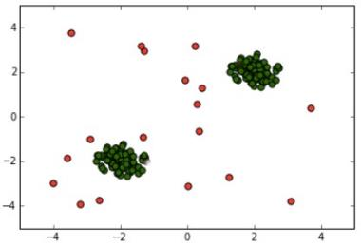
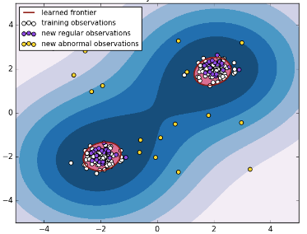
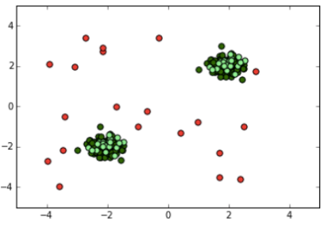
Anomaly Detection Methods Output
Unsupervised
Binary classification
Anomaly scores (confidence)
Supervised
  Hierarchical Neural Network
  Multi-instance Learning
Descriptive
Nearest Neighbor Based (distance or density)
Clustering Based
Pseudo semi-supervised:
Probabilities
Ranking
Semi-supervised
Binary classification
Anomaly scores
iForest
Inductive (general rules)+ Transductive (dataset specific)
Semi-Supervised Novelty Detection (SSND)
Learning from “Positive” and Unlabeled examples (LPUE)
Inductive (general rules)
Classification Based (one-class svn)
1CSVN
SSND, LPUE
Novelty detection: Novelties should occupy regions where the nominal density is high
Cécile Germain Anomaly detection In DataScience@HEP 2017
Notes:
▪ Binary class label, normal or anomalous (Early years)
▪ Numerical output (anomaly score), can be converted to binary output
▪ Used by semi-supervised and unsupervised algorithms
▪ The interpretation of outlier score depends on the algorithm.
▪ Some algorithms: only an ordering according to the scores make sense (ordinal scale)
▪ Other algorithms: reference point, 1.0 is normal behavior
▪ Probability (not possible with most algorithms), so the scores can be compared by different data set.

Slide 32
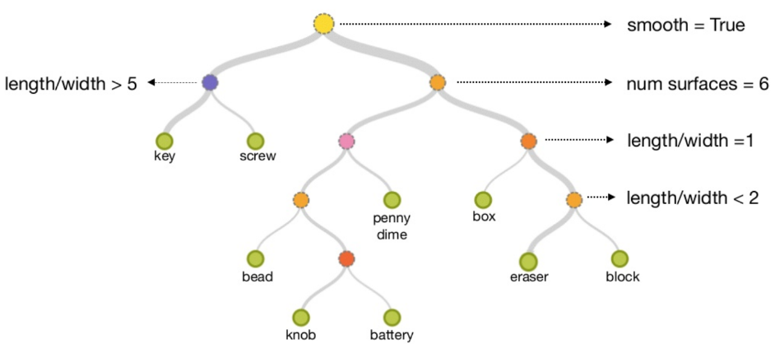
Random Trees
Build a decision tree from a random data subsample
F
T
F
T
Partition feature space using axis-parallel subdivisions
  Select the split feature A, randomly and uniformly
  Select the split value V_{A}, uniformly as the min(A)+(max(A)–min(A))*rand(1)
Grow a random tree until each data point is in its own leaf or the tree reaches a maximum height
https://www.slideshare.net/mlvlc/l14-anomaly-detection
Notes:
Knowing that splits matter: The order of splits is unknown!
A decision tree is a graphical representation of all the possible solutions to a decision based on certain conditions. It's called a decision tree because it starts with a single box (or root), which then branches off into a number of solutions, just like a tree. Decision trees are a type of model used for both classification and regression. The model behaves with “if this than that” conditions ultimately yielding a specific result.
Disadvantages of decision trees:
Building decision trees require algorithms capable of determining an optimal choice at each node.
Decision trees are prone to overfitting, especially when a tree is particularly deep.

Slide 33
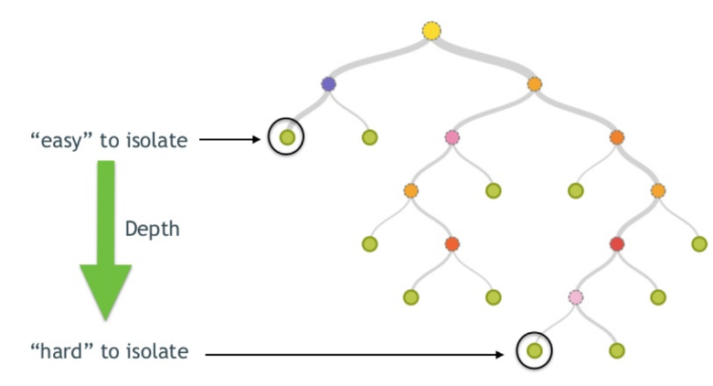
Isolation Forest [Liu et al. 2008]
To score a data point, find the height of the leaf node
  The smaller the height the more anomalous is the data
Build an ensemble of decision trees from randomly selected subsamples of size n
https://www.slideshare.net/mlvlc/l14-anomaly-detection
Notes:
https://cds.cern.ch/record/2030962?ln=en
The basic concept of Isolation Forest is to measure susceptibility or proneness of individual data instances to be isolated. Since anomalies are few and far from normal instances and therefore they are more inclined to isolation.
During the procedure of anomaly detection, random partitioning of instances according to the feature value is repeated recursively until all the instances are isolated or they meet a pre-defined termination criterion. Then those data points that are easily isolated are regarded as the anomalies with high possibility. Consequently, the more easily an observation data point is isolated, the more probability it carries to be regarded as the anomaly data point.
The assumptions are: the fewer instances of anomalies result in a smaller number of partitions (shorter path length) and the instances with distinguishable feature-values are more likely to be separated in early partitioning. Hence, when a forest of random trees collectively produce shorter path lengths for some particular points, then they are highly likely to be anomalies.
Of course, only a single isolation tree has probably a poor detection performance, isolation based anomaly detection method is an ensemble learning technique in essential, which needs to build multiple isolation trees to gain an aggregate decision. Consequently, ensemble detector is constructed for the given dataset at the training stage, which consists of N individual detectors.

Slide 34
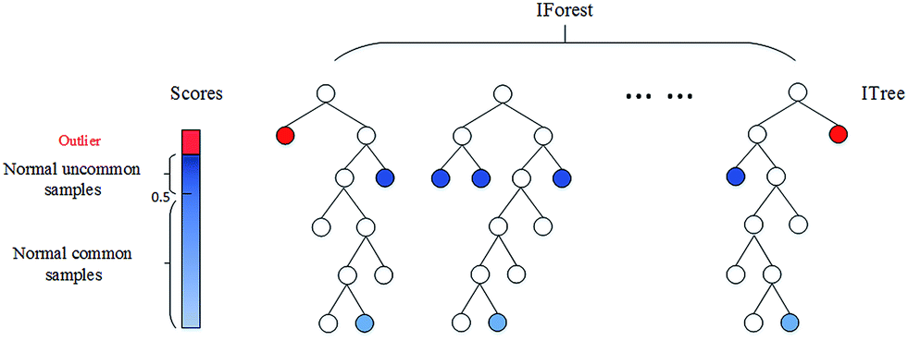
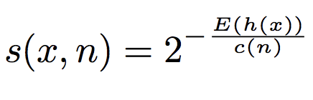
Isolation Forest Scores
Use average height to compute the anomaly score:
  0 (normality) 1 (abnormality)
Score
  Ensemble average path length to a data point
  Normalized by the expected path length of balanced binary search tree
https://towardsdatascience.com/a-brief-overview-of-outlier-detection-techniques-1e0b2c19e561
Notes:
Where h(x) is the path length of the sample x. E(h(x)) is the mean of h(x) taken over a forest of isolation trees. c(n) is the average path length of a binary tree from root to a leaf node, where n is the number of data points i.e. leaf nodes. After giving each observation a score ranging from 0 to 1, a threshold can then be specified (i.e., 0.55 or 0.60).
c(n) = 2H(n-1) – (2(n-1)/n) where H(i) is the harmonic number that can be estimated by log(i) + 0.5772156649 (euler's constant). As c(n) is the average of path length given n, we use it to normalize h(x).
When E(h(x)) -> c(n) => s -> 0.5
When E(h(x)) -> 0 => s -> 1
When E(h(x)) -> n-1 with n large => s -> 0

Slide 35
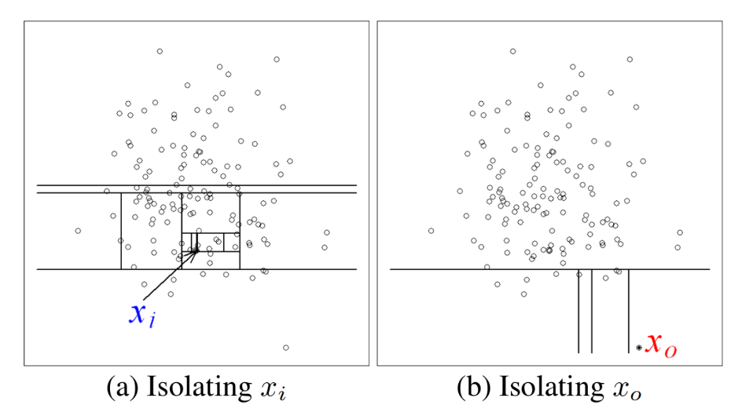
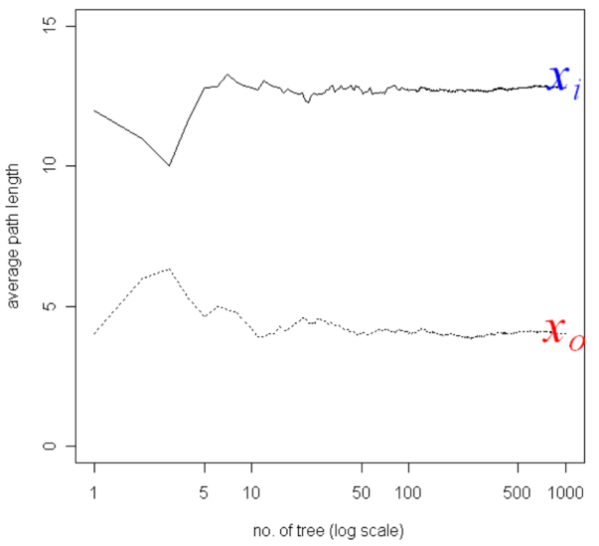
Isolation Forest Scores
12 partitions (not an anomaly)
4 partitions (anomaly)
https://www.depends-on-the-definition.com/detecting-network-attacks-with-isolation-forests/
Notes:
The isolation forest algorithm has several hyper-parameters: the subsampling size, the number of trees and the height of the tree.
n_estimators: The number of trees to use. The paper suggests an number of 100 trees, because the path lengths usually converges well before that.
max_samples: The number of samples to draw while build a single tree. This parameter is called sub-sampeling in the paper and they suggest max_samples=256, since it generally provides enough details to perform anomaly detection across a wide range of data.
contamination: The amount of contamination of the data set, i.e. the proportion of outliers in the data set. Used when fitting to define the threshold on the decision function.
The depth of the tree can be approximately calculated by log2 (number of data instances). Sub-sampling size (𝜓) controls the training data size. There is no need to increase the sub-sampling size beyond the desired value because it increases processing time and memory size without any gain in detection accuracy (Fayet et al., 2017; Liu et al., 2012). According to Liu et al. (2012), the sub-sampling size of 28 or 256 is enough to perform anomaly detection empirically. Number of tree (𝑇) controls the ensemble size. According to Liu et al. (2012), the path lengths usually converge well before t = 100.

Slide 36
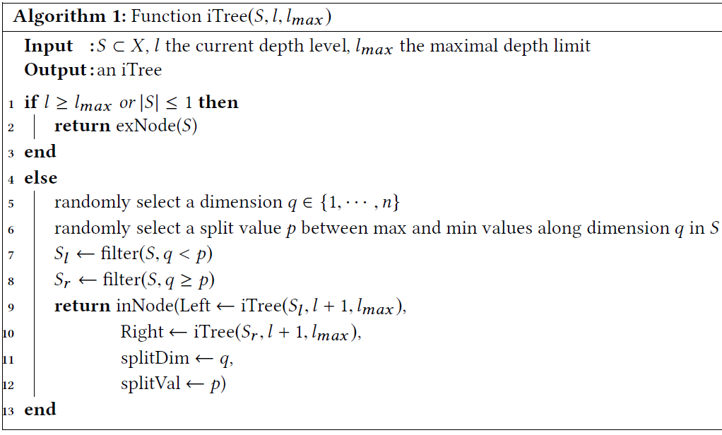
iTree Algorithm [Liu et al.2008]
Sample S randomly drown from X ≤ R^{d}

Slide 37
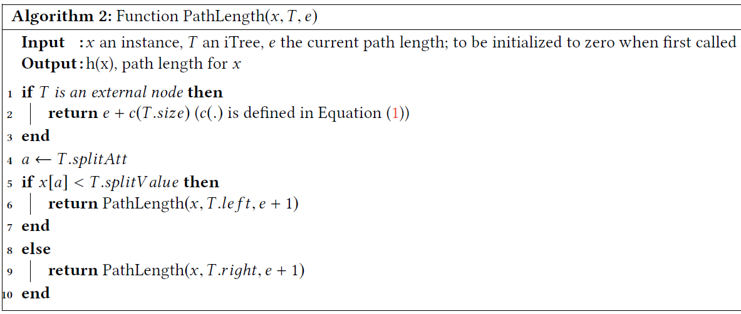
iForest Algorithm [Liu et al.2008]
Recursive Evaluation of h(x) of data point x given an iTree T and e the current path length

Slide 38
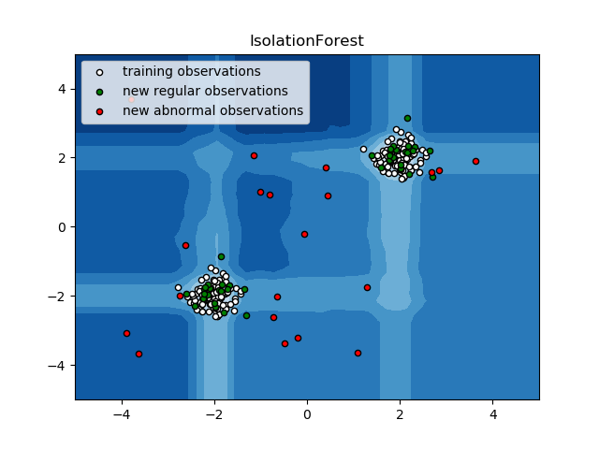
iForest: Use Cases
In case of missing values in features, use an imputation method to impute missing values first
If your features have categorical (nominal) values, consider using categorical to numerical analytics in our catalog to transfer dataset first
  One-Hot Encoding
Notes:
https://www.predix.io/api/catalog/analytics/artifacts/53ab5bc9-3c7a-4b64-ace2-14d5bb898a78/file?fileName= IsolationForestOutlier%20Documentation.pdf
If training data is provided with “Target” labels, iForest AD will be used as a supervised learning algorithm
the labels should be “1” stands for normal data and “-1” for anomalies
If training data is missing “Target” labels, iForest AD will be used as an unsupervised learning algorithm

Slide 39
iForest: Pros and Cons
Pros
  Very easy to construct (no distance/density function needed) avoiding hard decisions whether a data point is an anomaly or not
    assigns an anomalous score to each of the testing data point
  Achieve a sublinear time-complexity and a small memory-footprint
    By exploiting subsampling
    By eliminating major computational cost of distance calculation in all the distance-based and density-based AD methods
  Can provide anomaly explanations [Siddiqui et al. 2015]
Cons
  Hyper-parameter tuning (e.g. number/height of trees, sample size)
    Large datasets will need more isolation trees (how many?)
  Requires a high percentage of relevant features to identify anomalies [Bandaragoda et al. 2018]
    In presence of features that do not provide information over the anomaly, iForest increases height randomly by ignoring this fact
Notes:
iForest success in low to moderate dimensional data -> choice of dimension not that crucial
Need extensions to handle discrete values and nominal data
Isolation based method has linear time complexity with low computational and memory requirement, which implies that this method can detect anomaly fast and save the memory resource effectively.
Gracefully handles missing values at scoring time
Robust against masking and swamping effects: “masking” of an outlier as a nonoutlier (Type I error), and “swamping” of a nonoutlier as an outlier (Type II error)
The axis-parallel subdivisions may mask global anomalies that exist in between axis-parallel clusters.
Like in all Decision Trees sensitive to sample size of training data
If trained on a small sample of normal points it fails to generalise on normal points that differ significantly from training
Most anomalies are absent from training data
Unclear streaming implementation
decision_function for OCSVM is such that if the value is positive then the sample is an inlier and if negative then it is an outlier. It takes into account the parameter nu which can be seen as a contamination parameter. The decision_function of IsolationForest does not take into account the contamination parameter, it just returns the score of the samples. For LOF, it is private _decision_function and does not take into account the contamination parameter. For EllipticEnveloppe, decision_function takes into account the contamination parameter and it is said in the documentation that it is meant to "ensure a compatibility with other outlier detection tools such as the One-Class SVM".
https://github.com/scikit-learn/scikit-learn/issues/8693

Slide 40
Variants of Decision Trees & Forests
Tree-based:
  h:d-Trees [Ting and Wells, ICDM 2010]
  Streaming Half-Space-Trees (HSTA) [Tan et al, IJCAI 2011]
  RS-Forest [Wu et al, ICDM 2014)
  Robust Random Cut Forest (RRCF) for data streams [Guha et al, ICML 2016]
Irrelevant dimensions
  Nearest neighbor [Wells et al, PRJ 2014]
  Half-Space [Ting et al, KDD 2010; Chen et al, MLJ 2015]
Notes:
Streaming Half-Space-Trees (hsta) (Tan et al, 2011) randomly construct a binary tree structure without any data. It selects a dimension at random and splits it in half. Each tree then counts the number of instances from the training set at each node referred to as “mass”. The score for a new instance is then proportional to the mass in the leaf in which new instance hits after passing down the tree. Obviously, an ensemble of such trees can be built-in constant time and the training is linear in n. However, randomly splitting a very high-dimensional space will not yield in a tree sufficiently fine-grained for anomaly detection. The RS-Forest (Wu et al, 2014) is a modification of hsta in which each dimension is not splitted in half, but at a random cut-point. Also the assumption that “[. . .] once each instance is scored, streaming RS-Forest will receive the true label of the instance [. . .]” (Wu et al, 2014) does not always hold.

Slide 41
One-Class Support Vector Machines [Scholkopf et al, 1999]
Instead of dividing data samples by class as SVM algorithms, 1CSVMs consider all samples as members of the normal class, and find the boundary that best fits the given data, dividing it from the origin
  model the underlying distribution of normal data while being insensitive to noise or anomalies in the training data
  after the training is finished, the testing simply involves classifying a sample as normal or anomalous depending on which side of the found boundary they are mapped
A kernel function implicitly maps the input data space to a higher dimensional feature space in order to clearly separate between normal and anomalous data
  When properly applied, in principle a kernel-based method is able to model any non-linear pattern of normal behavior
Notes:
Supervised SVMs (or lSVM, short for labelled SVM) are not always practical for anomaly detection, due to their need for labelled training data that identifies both normal and anomalous records in the dataset, or relying on “pure” normal data that are free of any anomalies. Such training datasets are expensive to compile in practice. Semi-supervised anomaly detection approaches such as 1SVMs overcome this challenge by constructing a nonlinear model of normal behavior, where data points that deviate from the normal model are identified as anomalies.
By using a Mercer kernel function, the data vectors are implicitly mapped to a higher dimensional inner product space without any knowledge of the mapping function. The boundaries found in the implicit feature space usually yield a non-linear boundary in the input space.

Slide 42
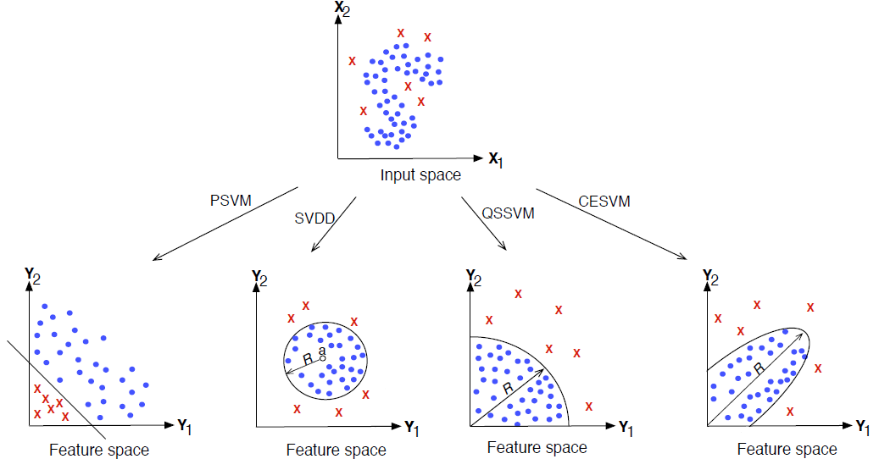


Various 1CSVM Methods
Find a hyperplane (in higher-dimensional kernel space) such that most of the data are separated from the origin with maximum margin
The optimal hyperplane maximizes the support vectors length.
Tradeoff between amount of data enclosed and tightness of enclosure; controlled by regularization of slack variables
PSVM (Plane-based Support Vector Machine)
SVDD (Support Vector Data Description)
QSSVM (Quarter- Sphere Support Vector Machine)
CESVM (Centered Hyperellipsoidal Support Vector Machine)
S. M. Erfani Anomaly Detection in Participatory Sensing Networks Ph.D Univ. of Melbourne August 2015
Notes:
If our feature space (The amount of columns in our dataset) is 1 dimensional, a hyperplane would be a point. Is the feature space 2 dimensional, than the hyperplane is a line. In a 3 dimensional feature space the hyperplane is a plane. Formally a hyperplane is a geometric space one dimension less than the feature space. The SVM must find the optimal hyperplane that splits the observed data points best. Therefore there needs to be a definition of optimal separating hyperplane. The optimal hyperplane is defined by the plane that maximizes the perpendicular distance between the hyperplane and the closest samples. This perpendicular distance can be spanned with support vectors.
Recently, several 1SVM methods have been proposed for anomaly detection and some of the state-of-the-art 1SVM formulations are presented in the above Figure. The Figure shows a simple dataset. Normal records are represented with solid dots and anomalies with crosses. The figures on the bottom, show the data projected to a higher dimensional space using four different 1SVM approaches.
This approach does not scale very well to large datasets where predictions have to be made with high frequency. As, Steinwart (2003) showed that the number of support vectors can grow linearly in the size of the dataset. There exist One-class support vector machines which can be learned incrementally (Gretton and Desobry, 2003).

Slide 43
One-Class Support Vector Machines
Decision function is +1 in a small region capturing most of the support, and -1 elsewhere
Kernel trick, with the feature map F
  https://youtu.be/3liCbRZPrZA
Separate the transformed data from the origin with maximum margin
Strictly-speaking, 1CSVM is not an outlier-detection, but a novelty-detection method
  its training set should not be contaminated by outliers as it may fit them!
Train : standard normal distribution
Regular : standard normal distribution
Abnormal : uniform
ν = 0.1
Notes:
A very nice property of SVMs is that it can create a non-linear decision boundary by projecting the data through a non-linear function ϕ to a space with a higher dimension. This means that data points which can’t be separated by a straight line in their original space I are “lifted” to a feature space F where there can be a “straight” hyperplane that separates the data points of one class from an other. When that hyperplane would be projected back to the input space I, it would have the form of a non-linear curve. The following video illustrates this process; the blue dots (in the white circle) can not be linearly separated from the red dots. By using a polynomial kernel for projection (later more on that) all the dots are lifted into the third dimension, in which a hyperplane can be used for separation. When the intersection of the plane with the space is projected back to the two dimensional space, a circular boundary arises.
http://rvlasveld.github.io/blog/2013/07/12/introduction-to-one-class-support-vector-machines/

Slide 44
Performance Measures of AD Algorithms
Confusion Matrix | Actual Normal Data (n_{n}) | Actual Anomalous Data (n_{a})
Predicted Non-anomalies | TN | FN
Predicted Anomalies | FP | TP
Accuracy Rate (ACC) = (TP + TN ) / (TN + FP + FN + TP)
False Alarm –Positive– Rate (FAR) = FP/ (FP + TN)
True Positive –Detection– Rate (TPR) = TP/ (TP + FN)
Receiver Operating Characteristic (ROC)= tradeoff between TPR&FAR
Area Under the ROC Curve (AUC): can be computed by a slight modification of the algorithm for constructing ROC curves
True negative rate (specificity): ratio between the number of correctly detected normal data (TN) and the total number of normal (TN+FP) data
precision: ratio between the number of normal data that are misclassified (FP) as anomalies and the total number of data records from normal class (TN+FP)
recall (sensitivity): ratio between the number of correctly detected anomalies (TP) and the total number of anomalies (TP+FN)
Notes:
A confusion matrix as shown in Table is typically used to evaluate performance of a machine learning algorithm. In this table, it is considered that anomaly class is positive and normal (non-anomaly) class is negative. Therefore, True Negative is the number of correctly predicted non-anomalies. True Positive is the number of correctly predicted anomalies. False Negative is the number of actual anomalies which are predicted as non-anomalies. False Positive is the number of non-anomalies which are predicted as anomalies.
To evaluate our proposed algorithm, four performance metrics are selected. The first is the accuracy rate (ACC), which is a traditional metric used to evaluate the classifier performance in the community of data mining and machine learning. ACC represents the percentage of right prediction. The second is the true positive rate (TPR), which represents the percentage of anomalies that are correctly detected, i.e., the ratio between the number of correctly detected anomalies and the total number of anomalies. The third is the false alarm rate (FAR) or false positive rate (FPR), which represents the percentage of normal data that
are incorrectly considered as anomalies, i.e., the ratio between the number of normal data detected as anomalies and the total number of normal data. Compared to the TPR and FAR, the area under cover (AUC) is widely used to measure the overall performance of anomaly detector regardless of the threshold
between the true positive and true negative. The calculation formula is described in
D. J. Hand, R. J. Till. A simple generalisation of the area under the ROC curve for multiple class classification problems. Machine Learning, vol. 45, no. 2, pp. 171–186, 2001.

Slide 45
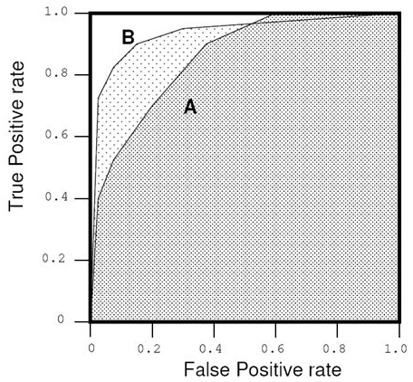
ROC Spaces and AUC
Ideal ROC curve
ROC curves are two dimensional plots in which the true positive (TP) rate is platen on the Y axis and the false positive (FP) rate on the X axis
Area Under the ROC Curve (AUC) has an important statistical property:
  The AUC of a classifier is equivalent with the probability that the classifier will rank a randomly chosen positive instance higher than a randomly chosen negative instance
  When comparing classifiers, the bigger AUC the better!
ROC curve of Algo B
ROC curve of Algo A
(sensitivity)
AUC
(1- specificity)
http://slideplayer.com/slide/5379166/
Notes:
https://en.wikipedia.org/wiki/Receiver_operating_characteristic
In statistics, a receiver operating characteristic curve, i.e. ROC curve, is a graphical plot that illustrates the diagnostic ability of a binary classifier system as its discrimination threshold is varied.

Slide 46
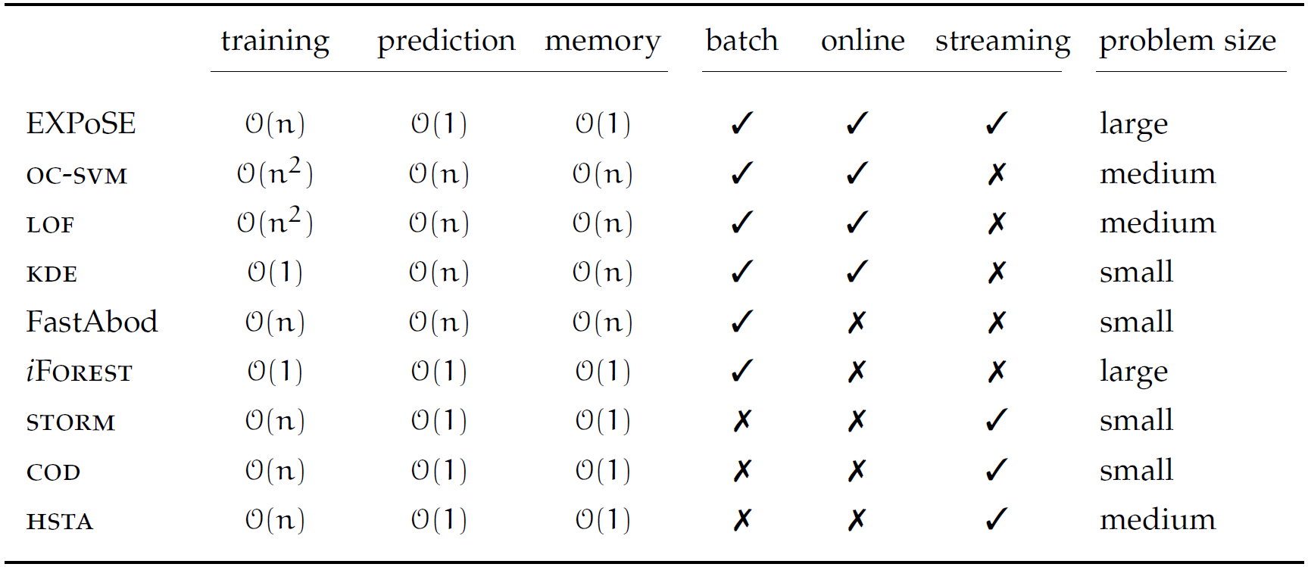
Computational Complexity of AD Algorithms
DISTRIBUTION BASED MODELS
Kernel (or Parzen) density estimator (kde)
One-Class SVN (oc-svn)
-----
Robust PCA (RobustPCA)
Self-Organizing Maps (son)
DISTANCE BASED MODELS
STream OutlieR Miner (storm)
Continuous Outlier Detection (cod)
DENSITY BASED MODELS
Local Outlier Factor (lof)
Angle Based Outlier Detection (abod) and FastAbod
ISOLATION BASED MODELS
Isolation Forest (iForest)
M Schneider, W. Ertel, F. Ramos. Expected Similarity Estimation for Large-Scale Batch and Streaming Anomaly Detection Machine Learning, 105(3) Dec. 2016
Notes:
The characteristics of the most relevant anomaly detection algorithms is summarized in Table. All
complexities are given with respect to the dataset size n in high-dimensional spaces.
Most methods discussed do not scale to very large problems since either the training time is non-linear with the number of samples or the time to make a single prediction increases with the dataset size (stream length)

Slide 47
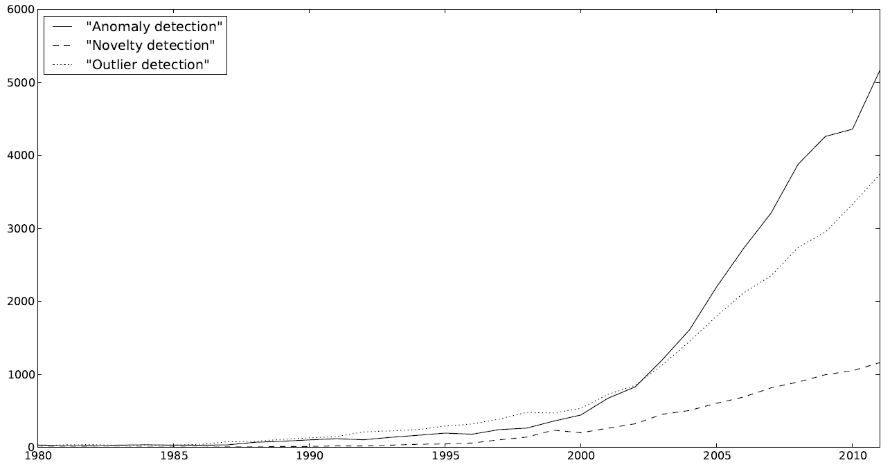
Summary
number of papers published on
AD algorithms usually report different outliers per dataset
  they may miss obvious outliers especially in heterogeneous datasets that contain a mixture of numerical and categorical attributes
Which anomaly detection method to use depends on
  Data characteristics: dimensionality (Univariate, Multivariate) and type (categorical numerical)
  Anomaly characteristics: type (Point, Collective), semantics (Set-based, Sequence-based), kind (Binary, Score)
  Availability of labels: supervised, unsupervised, semi-supervised
  Algorithmic properties: computational cost (exponential vs linear), prior knowledge (parametric, non-parametric), distributional/ incremental computation potential, …
Source: Google Scholar
How we can automate the selection of the most suitable AD algorithm for a particular dataset with minimal human involvement and within limited computational budgets?
Notes:
In recent years, anomaly detection has become increasingly important in a variety of domains in business,
science and technology. Roughly defined as the automated detection within data sets of elements that
are somehow abnormal, anomaly detection encompasses a broad set of techniques and problems. In
part due to the emergence of new application domains, and in part due to the evolving nature of many
traditional domains, new applications of and approaches to anomaly detection and related subjects are
being developed at an increasing rate, as indicated in Figure.

Slide 48
Anomaly Detection in Data Streams

Slide 49
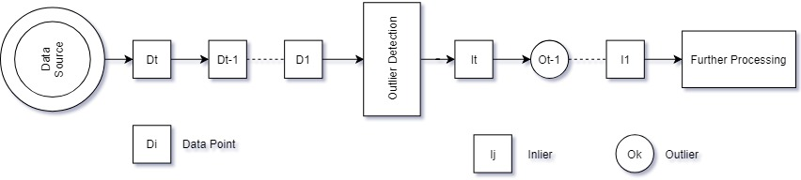
Offline vs Online Anomaly Detection
A data stream is a possible infinite series of data points ..., o_{n−2}, o_{n−1}, o_{n}, ..., where data point o_{n} is received at time o_{n}.t.
Offline learning (for finite streams):
  All data is stored and can be accessed in multiple passes
  Learned model is static
  Potentially high memory and processing overhead
Online learning (for infinite streams):
  Single pass over the data which are discarded after being processed
  Learned model is updated : one point at a time or in mini-batches
  Low memory and processing overhead
Notes:
Batch learning Consuming all training examples at once
Incremental learning Consuming one example at a time
Mini-batch learning Consuming several examples at a time
Streaming algorithms have many similarities with Online algorithms since they both require decisions to be made before all data are available, but they are not identical. Data stream algorithms only have limited memory available but they may be able to defer action until a group of points arrive, while online algorithms are required to take action as soon as each point arrives.

Slide 50

Online Anomaly Detection: Challenges
Limited computational resources for unbounded data
  window-based algorithms
High speed data streams:
  the rate of updating a detection model should be higher than the arrival rate of data
Both normal and anomalous data characteristics may evolve in time and hence detector models need to quickly adjust to concept drifts/shifts:
  adversarial situations (fraud, insider threats)
  diverse set of potential causes (novel device failure modes)
  user’s notion of “anomaly” may change with time
Online ML
Notes:
Data are streaming in at high speed and hence must be processed in a timely manner
This requires that the rate of updating a detection model should be higher than the data rate, and the obtained detector must be able to adapt to the high speed nature of streaming information
Conventional anomaly detection algorithms need data to be resident in memory for model construction
This array of methods will be nullified by the voluminous unbounded data due to memory exhaustion
Third, in streaming data, normal and abnormal events keep evolving with the drifting concepts
Such incessant changes often outdate the detection models learned from old data
Therefore, the detector needs to quickly adjust to the evolution of normal behavior over time

Slide 51
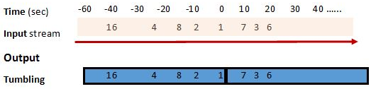
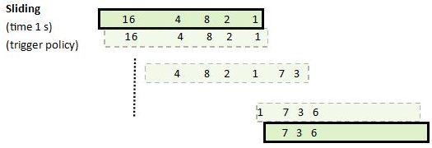

Windowing Semantics
https://stackoverflow.com/questions/12602368/sliding-vs-tumbling-windows
Notes:
Tumbling repeats at a non-overlapping interval.
Time Sliding triggers at regular interval.
Eviction Sliding triggers on a count.

Slide 52
Robust Random Cut Forest (RRCF) [Guha et al, ICML 2016]
Construct random trees as iForest but incrementally update their binary tree structure using sliding windows
  Traverse a tree to Insert a new point to a leaf node, use FIFO to remove the oldest point if this procedure exceeds the max number of leaf nodes
  Calculate the Displacement of the new point, as the number of leaf nodes that updated (moved/deleted) in a tree after the insertion
Principled definitions of anomalies
  Calculate the Collusive Displacement (CD) of a new point in a tree, as the maximal displacement across all nodes traversed in a path from the root
  Outliers correspond to points that their average CD in the forest is large, instead of small average tree height
Address iForest limitation in case of multiple irrelevant features
  Does not uniformly selects the split feature
Notes:
Displacement = number of observations on the sibling leaf / number of observations of current leaf
CoDisp is average of maximal displacement which can be achieved by deleting this point and its neighbors divided by number of points deleted
Collusive Displacement sees Displacement at each tree depth from leaf to root and assigns as CoDisp the maximal displacement observed by that.
By assigning weights on each observation based on the time of their arrival, latest observations contribute more to the Displacement turning it to
Displacement = sum of weights of observations on the sibling leaf / sum of weights of observations of current leaf
Previous version
“Insert a new point in a Tree as it was available during training and remove the oldest points if the Tree grows above a permitted size”

Slide 53
RRCF : Example
Given the following input stream of points 𝑆
Key
…
Screw
Dime
Knob
Battery
Box
Block
Penny
Eraser
  Start by collecting the first w = 7 points of 𝑆, as a Initial Training Sample 𝑥={𝑥₁,𝑥₂,…, 𝑥_{𝑗}} where 𝑥_{i} ∈ 𝑅^{d}, in order to build the initial Tree
  Assumption :
    all objects within x are considered as inliers

Slide 54



RRCF Tree Construction: Example
Object | L/W | NS | S
Screw | 8 | 3 | 0
Dime | 1 | 3 | 1
Knob | 1 | 4 | 1
Battery | 5 | 3 | 1
Box | 1 | 6 | 1
Block | 1.6 | 6 | 1
Penny | 1 | 2 | 1
Consider the value range per feature $l_{i}= \max_{x}{x_{i}}−\min_{x}{x_{i}}$
Pick a spliting feature w.r.t. its normalized value range $\frac{l_{i}}{\sum_{j}{l_{j}}}$
 | L/W | NS | S
Minimum value | 1 | 2 | 0
Maximum Value | 8 | 6 | 1
Range | 7 | 4 | 1
Choose uniformly a splitting value $X_{i}\sim Uniform[\min_{x}{x_{i}},\max_{x}{x_{i}}]$
Length/Width (L/W), Num Surface (NS),Smooth (S)
Notes:
The greater its value range the more probable a dimension to be selected

Slide 55
RRCF Tree Construction: Example
L/W<3.3
Object | L/W | NS | S
Dime | 1 | 3 | 1
Knob | 1 | 4 | 1
Penny | 1 | 2 | 1
Range | 0 | 2 | 0
Object | L/W | NS | S
Dime | 1 | 3 | 1
Knob | 1 | 4 | 1
Range | 0 | 1 | 0
Object | L/W | NS | S
Box | 1 | 6 | 1
Block | 1.6 | 6 | 1
Range | 0.6 | 0 | 0
Object | L/W | NS | S
Screw | 8 | 3 | 0
Battery | 5 | 3 | 1
Range | 3 | 0 | 1
Object | L/W | NS | S
Dime | 1 | 3 | 1
Knob | 1 | 4 | 1
Box | 1 | 6 | 1
Block | 1.6 | 6 | 1
Penny | 1 | 2 | 1
Range | 0.6 | 4 | 0
NS<5.1
L/W <5.2
Battery
Screw
NS<2.3
L/W<1.2
Penny
NS<3.2
Box
Block
Dime
Knob
Note that: Each (internal) child node has a sub-space (bound) feature value range of its parent node
Length/Width (L/W), Num Surface (NS),Smooth (S)
Notes:
The greater its value range the more probable a dimension to be selected

Slide 56


Slide 57
RRCF Tree Update: Example
Consider the new object Eraser, by sliding the window by one point
Eraser
Object | L/W | NS | S
Eraser | 2.75 | 6 | 1
L/W<3.3
NS<5.1
L/W <5.2
NS<2.3
L/W<1.2
NS<3.2
L/W<2
 | L/W | NS | S
Minimum value | 1 | 2 | 1
Maximum Value | 1.6 | 6 | 1
At New Leaf | L/W | NS | S
Minimum value | 2 | 6 | 1
Maximum Value | 2.75 | 6 | 1
 | L/W | NS | S
Minimum value | 1 | 2 | 0
Maximum Value | 8 | 6 | 1
At Leaf | L/W | NS | S
Minimum value | 1 | 6 | 0
Maximum Value | 1.6 | 6 | 1
 | L/W | NS | S
Minimum value | 1 | 6 | 1
Maximum Value | 1.6 | 6 | 1
Out of leaf bounds
IF the current node is internal, Then check rules to traverse and that the point lies inside bounds
A new tree instance has been computed
  In theory update tree to the new instance only if low CoDisp(Eraser)
Notes:
Traverse tree until we meet leaf
If within leaf bounds : inlier
If without leaf bounds : update tree and calculate CoDisp
NOT specifically declared by authors but implied by the processes : each node has information about splitting dimension, splitting value, dimension ranges based on so far observations
Each matrix depicts the subspace viewed by the respective internal node

Slide 58


RRCF Tree Update: Example
Object | L/W | NS | S
Eraser | 2.75 | 6 | 1
L/W<3.3
NS<5.1
L/W <5.2
NS<2.3
L/W<1.2
NS<3.2
Leaves at sibling : 3
Leaves at current : 3
L/W<2
Leaves at sibling : 1
Leaves at current : 1
Leaves at sibling : 2
Leaves at current : 6
Leaves at sibling : 1
Leaves at current : 2
Update range
$$CoDisp\left(Eraser\right)=\max\left(Displacement\right)=1< Threshold=1.5$$
$$Displacement\left({Data Point}_{depth}\right)=\frac{leaves of sibling node}{leaves of current node}$$
$Disp\left(Eraser_{4}\right)=\frac{1}{1}$
$Disp\left(Eraser_{3}\right)=\frac{1}{2}$
$Disp\left(Eraser_{2}\right)=\frac{3}{3}$
$Disp\left(Eraser_{1}\right)=\frac{2}{6}$
Notes:
does not change significantly the overall bits required to navigate the tree = each bit denotes which subtree to follow
ex.
For left 1, for right 0
to reach leaf “Knob” the path would be 1100

Slide 59
RRCF Anomalies: Example
Consider the new object Key, by sliding the window by one point
Key
L/W<3.3
Object | L/W | NS | S
Key | 4.25 | 3 | 0
NS<5.1
L/W <5.2
NS<2.3
L/W<1.2
S<0.5
NS<3.2
L/W<2
At New Leaf | L/W | NS | S
Minimum value | 4.25 | 3 | 0
Maximum Value | 5.2 | 3 | 0
Range | 0.95 | 0 | 0
At Leaf | L/W | NS | S
Minimum value | 5 | 3 | 1
Maximum Value | 5.2 | 3 | 1
Range | 0.2 | 0 | 0
 | L/W | NS | S
Minimum value | 5 | 3 | 0
Maximum Value | 8 | 3 | 1
 | L/W | NS | S
Minimum value | 1 | 2 | 0
Maximum Value | 8 | 6 | 1
Out of leaf bounds

Slide 60



RRCF Anomalies: Example
L/W<3.3
Object | L/W | NS | S
Key | 4.25 | 3 | 0
NS<5.1
L/W <5.2
NS<2.3
L/W<1.2
S<0.5
NS<3.2
$$Displacement\left({Data Point}_{depth}\right)=\frac{leaves of sibling node}{leaves of current node}$$
Key -> Outlier
Should discard changes and Keep Original Tree
$Disp\left({Key}_{3}\right)=\frac{1}{1}$
$Disp\left({Key}_{2}\right)=\frac{1}{2}$
$Disp\left({Key}_{1}\right)=\frac{6}{3}$
$CoDisp\left(Eraser\right)=\max\left(Displacement\right)=$2 > $Threshold=1.5$

Slide 61


Slide 62



RRCF Complexity
RRCF Building Complexity
$$O\left(t \left(n\right)\right)$$
Worst case : perfect binary tree,
where each data point is a leaf
RRCF Updating Complexity
$$O\left(t \left(log2\left(n\right)\right)\right)$$
Worst case : perfect binary tree,
where each new data point is a new leaf at the maximal height updating the entire subtree
Where,
  t is the number of trees
  n is the maximum number of data points in a tree
  $\left(2n−1\right)$ is the total number of nodes of a perfect binary tree with n leaves
  $log2\left(n\right)$ is the minimal height of a perfect binary tree with n leaves
  Tree height is increased by 1 after processing a new data point
Notes:
S user defined hyper parameter of the algorithm that defines number of leaf neighbors to be deleted with the observation in order to calculate Collusive Displacement.
If S=0 then we just calculate Displacement
For each neighbor leaf (S) deletion, its parent node is deleted also -> (2*S) + the observation + parent of observation = (2*S+2)
a binary tree with n leaves has height at least log(n).
The number of nodes n in a full binary tree, is at least n = 2*h + 1 and at most n = 2^(h + 1) − 1, where h is the height of the tree.
A tree consisting of only a root node has a height of 0.
Number of leaves at height h are l=2^h
a perfect binary tree with l leaves has n = 2 l − 1 nodes.

Slide 63
RRCF Summary
RRCF chooses a splitting feature proportionally to its value range and not uniformly
  Formally proves that tree structure updates are equivalent as if the data point were available during training
  Tackles the presence of irrelevant dimensions towards outlier isolation
RRCF determines distance based anomalies without focusing on the specifics of the distance function
  Define anomalies using high average of collusive displacement instead of low average tree height
  Tackles efficiently finer differences between outliers and inliers (masking)
RRCF hyper-parameters include the CoDisp threshold
  As CoDisp is not normalized, we should first normalize the maximal displacements in a tree before computing their average in the forest
  It is open how to tune threshold, in the normalized range [0, 1], to accurately separate normal from abnormal points

Slide 64

Half Space Trees (HST)
[Tan et al, IJCAI 2011; Chen et al, MLJ 2015]
Randomly construct small binary trees as iForest, but
  For each feature define its workspace
  A HST bisects data space using randomly selected features and the middle value of its workspace
  A node in a HST captures the number of points within a particular subspace, called Mass profile
Incrementally update the Mass profiles of the tree/s, for every new tumbling window, to learn the density of the stream
  Transfer the non-zero mass of the last window to the model computed in the previous window
✔
✘
Anomalies can be inferred using the current window points
  Points are ranked in their ascending score order
  The lower the score of a point, the more probable to be an anomaly
✘
Example: A HST on a 2D Stream
Notes:
Streaming Half-Space-Trees (hsta) (Tan et al, 2011) randomly construct a binary tree structure without any data. It selects a dimension at random and splits it in half. Each tree then counts the number of instances from the training set at each node referred to as “mass”. The score for a new instance is then proportional to the mass in the leaf in which new instance hits after passing down the tree. Obviously, an ensemble of such trees can be built-in constant time and the training is linear in n. However, randomly splitting a very high-dimensional space will not yield in a tree sufficiently fine-grained for anomaly detection. The RS-Forest (Wu et al, 2014) is a modification of hsta in which each dimension is not splitted in half, but at a random cut-point. Also the assumption that “[. . .] once each instance is scored, streaming RS-Forest will receive the true label of the instance [. . .]” (Wu et al, 2014) does not always hold.
✔ -> High mass -> Inliers
✘ -> Low mass -> Outliers

Slide 65
HST Stream Snapshot: Example
Given a stream of objects, lets say 8 objects
Box
Block
Bead
Penny
Screw
Dime
Knob
Battery
…
Process the stream using tumbling windows of length w = 4
  Start by collecting the first w objects, as a Reference window
Object | L/W | NS | S
Box | 1 | 6 | 1
Block | 1.6 | 6 | 1
Bead | 1 | 2 | 1
Penny | 1 | 3 | 1

Slide 66
HST Workspace: Example
Compute the Workspace of each feature, using the reference window
Work range: Minimum, Maximum, Split and Range values of features
Object | L/W | NS | S
Box | 1 | 6 | 1
Block | 1.6 | 6 | 1
Bead | 1 | 2 | 1
Penny | 1 | 3 | 1
Workrange | L/W | NS | S
Minimum | 1 | 2 | 1
Maximum | 1.6 | 6 | 1
Split | 1.55 | 5.38 | 1
Range | 1.10 | 6.76 | 0
(A)
Work space: Max, Min values of the features’ work range
(B)
Split = Minimum + (Maximum – Minimum) * rand(1, 3)
Range = 2 * max( (Split – Minimum) , (Maximum – Split) )
Workspace | L/W | NS | S
Max | 2.66 | 12.14 | 1
Min | 0.45 | -1.38 | 1
Max = Split + Range
Min = Split – Range

Slide 67
HST Construction: Example
Construct a HST using the features’ work space
Randomly select a feature F
Workspace | L/W | NS | S
Max | 2.66 | 12.14 | 1
Min | 0.45 | -1.38 | 1
Split data space using the mid value SP_{F}
Initialize the mass profile
Control tree growth, using the objects of the reference window
r = 0
L/W
l = 0
Object | L/W | NS | S
Box | 1 | 6 | 1
Block | 1.6 | 6 | 1
Bead | 1 | 2 | 1
Penny | 1 | 3 | 1
=< 1.56
> 1.56
r = 0
l = 0
NS
=< 5.38
> 5.38
r = 0
l = 0
Activated: Max Height Limit = 2
Activated: Object Size Limit = 1
r = 0
r = 0
l = 0
l = 0

Slide 68
HST Mass Update: Example
Update the Mass_{r} Profile of the HST, using the objects of the reference window
  Increase by one the r mass of visited nodes
r = 3+1
r = 2+1
r = 0+1
r = 0
r = 1+1
L/W
Object | L/W | NS | S
Box | 1 | 6 | 1
Block | 1.6 | 6 | 1
Bead | 1 | 2 | 1
Penny | 1 | 3 | 1
=< 1.56
> 1.56
•
•
•
r = 1+1
r = 2+1
r = 0+1
r = 0
r = 1
NS
•
=< 5.38
> 5.38
r = 0
r = 0+1
r = 1
r = 1+1
r = 0+1
r = 0
r = 0
r = 0+1
r = 1

Slide 69
HST Stream Snapshot: Example
Process of the reference window has been completed
Box
Block
Bead
Penny
Screw
Dime
Knob
Battery
…
  Continue by collecting the next w objects, as a Latest window
Object | L/W | NS | S
Screw | 8 | 3 | 0
Dime | 1 | 3 | 1
knob | 1 | 4 | 1
Battery | 5 | 3 | 1

Slide 70
HST Anomaly Detection: Example
Detect anomalies in the latest window, using the current HST Model
Object | L/W | NS | S
Screw | 8 | 3 | 0
Dime | 1 | 3 | 1
knob | 1 | 4 | 1
Battery | 5 | 3 | 1
•
•
L/W
r = 4
•
•
=< 1.56
> 1.56
r = 3
NS
Object | Score | Rank
Screw
Dime
knob
Battery
=< 5.38
> 5.38
2
1st
1
r = 1
8
2nd
0
8
2nd
0
2
1
r = 2
r = 1
1st
Predict_{Obj} = Score_{obj} < mean(score) : 1 ? 0
Score = Node*.r x 2^{Node*.k}
Notes:
Node* = Leaf node.
Node*.r = the Mass r of a leaf node.
Node*.k = the depth of the leaf node.
To mean(score) είναι ένα threshold το οποίο ορίζουμε αυθαίρετα (hyper parameter) για να εκτιμήσουμε πιο αντικείμενο είναι outlier και πιο είναι inlier, χρησιμοποιώντας τα scores αυτών. Τα (✘) είναι outliers. Τα (✔) είναι inliers.

Slide 71
HST Mass Update: Example
Update Mass_{l} Profile of the HST, using the objects of the latest window
  Increase by one the mass of all visited nodes in the path to a leaf
l = 2 + 1
l = 3 + 1
l = 0
l = 0 + 1
L/W
l = 1 + 1
Object | L/W | NS | S
Screw | 8 | 3 | 0
Dime | 1 | 3 | 1
knob | 1 | 4 | 1
Battery | 5 | 3 | 1
•
•
=< 1.56
> 1.56
•
l = 0
l = 2
l = 1+1
l = 0+1
NS
•
=< 5.38
> 5.38
l = 0
l = 1
l = 0+1
l = 1+1
l = 0
l = 0
l = 2
l = 1+1
l = 0+1

Slide 72
HST Mass Update: Example
Aggregate the HST Mass Profile, before continue to the next window
  Transfer the non-zero Mass_{l} to the Mass_{r} profile
r = 4
r = 8
L/W
l = 4
L/W
l = 4
l = 0
=< 1.56
> 1.56
=< 1.56
> 1.56
r = 3
r = 5
l = 2
NS
NS
l = 2
l = 0
=< 5.38
> 5.38
r = 1
=< 5.38
> 5.38
r = 3
l = 2
l = 2
l = 0
r = 2
r = 1
r = 4
r = 1
l = 2
l = 0
l = 0
l = 2
l = 0

Slide 73
HST Stream Snapshot: Example
Process of the current latest window has been completed
Screw
Dime
Knob
Battery
Easer
Key
Paper
Pin
…
  Continue by collecting the final w objects as a Latest window
Object | L/W | NS | S
Easer | 1.6 | 6 | 1
Key | 4.25 | 3 | 0
Paper | 10 | 2 | 1
Pin | 1.14 | 3 | 0

Slide 74
HST Anomaly Detection: Example
Detect anomalies in the latest window, using the current HST Model
Object | L/W | NS | S
Easer | 1.6 | 6 | 1
Key | 4.25 | 3 | 0
Paper | 10 | 2 | 1
Pin | 1.14 | 3 | 0
•
•
L/W
r = 8
•
=< 1.56
> 1.56
•
r = 5
NS
Object | Score | Rank
Easer
Key
Paper
Pin
=< 5.38
> 5.38
r = 3
6
1st
1
6
1st
1
6
1st
1
r = 4
r = 1
16
2nd
0
Predict_{Obj} = Score_{obj} < mean(score) : 1 ? 0
Score = Node*.r x 2^{Node*.k}
Notes:
Node* = Leaf node.
Node*.r = the Mass r of a leaf node.
Node*.k = the depth of the leaf node.
To mean(score) είναι ένα threshold το οποίο ορίζουμε αυθαίρετα (hyper parameter) για να εκτιμήσουμε πιο αντικείμενο είναι outlier και πιο είναι inlier, χρησιμοποιώντας τα scores αυτών. Τα (✘) είναι outliers. Τα (✔) είναι inliers.

Slide 75


HST Complexity
HST Building Complexity
$$\text{O}\text{( }\text{t}\text{ ∗ }\text{2}\text{h}\text{+1}\text{ )}$$
Worst case : perfect binary tree,
where each data point is a leaf
HST Updating Complexity
$$\text{O}\text{( }\text{t}\text{ ∗ }\text{h}\text{ ∗ }\text{w}\text{)}$$
Worst case : perfect binary tree, where each new data point traverses requires to update the mass profiles of all sub trees
Where,
  t is the number of trees
  h is the max height of a tree
  w is the number of points in a window
  (2^{h+1}-1) is the number of all nodes of a perfect binary tree of max height h
Complexities are constant (amortized) when the h, t and w are set
Notes:
HS Trees has a significant advantage in terms of both time and space complexities. This is mainly due to the fact that HST only needs a small subsample to train a tree, where ψ << n; Ψ (also t and h) can be fixed in practice, regardless the size of the given stream.
Another distinguishing feature is that the time complexity of HST is independent of the dimensionality of the domain. Thus, the training time and memory space requirement are fixed – these properties make HST the ideal candidate to apply to domain with huge data size or infinite data such as data stream.
- - - - - - - - -
What is the distinction between Mass update and Model update?
Mass update means to update the mass.r or the mass.l of the nodes of a tree.
Model update means to add the non-zero mass.l to the mass.r of the nodes of the model and Reset the non-zero mass.l to zero.

Slide 76
HST Summary
HST workspace estimates the feature value ranges of future data in a stream, resulting to more accurate mass updates in stable distributions
HST structure initialized using the first reference window, and remains fixed for all streaming data
  Incrementally updating only the mass profiles of the HST model
HST ranks anomalies using a scoring function that considers only the mass profiles of the leaf nodes
HST fails to support concept drift when the statistical characteristics of features evolve over time
  incorrectly selected features may lead to inaccurate mass updates
One of the HST hyper-parameters is the size of tumbling windows
  How we can tune window size to tackle concept drift/shift?

Slide 77
Qualitative Comparison
Algorithm | Novelty | Splitting Feature | Splitting Value | Window Type | Anomaly Score | Model Update | Anomaly Types
IF | Avoids computation of distances/ densities | Uniform | Uniform | ✘ | Tree height | batch | Global & Local
RRCF | Addresses Masking & Irrelevant Features | Proportional to the feature range | Uniform | Slide | Collusive Disp. (sensitive to neighborhood) | Incremental tree updates | Global & Local; Sample based range subspace
HST | High Speed Data Streams | Uniform | Mid Value | Tumble | Mass Profiles (sensitive to neighborhood) | Mini-batch update of mass profiles | Global & Local; fixed range subspace
Notes:
All algorithms assume that training set consists only of inliers in order to construct trees, without mechanisms to compensate -> can lead to false negatives
HST assumes knowledge of dimension space -> could lead to false density mapping of feature space in case of extreme new observations
Due to practical dependency on training set inliers outside of the modeled distribution would be considered outliers (RRCF) or fail to assign to a leaf (HST)
RRCF sacrifices model update complexity in order to incrementally update model at each new observation. Each observation is classified with the latest possible model.
HST sacrifices model updates for speed. Each observation is classified with the model of the latest window, without taking into consideration observations within the current window
Although incrementally updating each new inlier is updating model without explicitly tackling drift detection
Smooth change would be incorporated within the model
Abrupt change would be found anomalous
Difference in windowing operations would cause HST more numb to such phenomena

Slide 78
On Going Benchmarking Efforts
Comparison of online algorithms with the same windowing operations and sampling schemes (e.g. Reservoir) to understand how window characteristics (size and speed) affect model update and sensitivity and distribution drifts
Evaluation of prediction quality on datasets with increasing dimensionality, to assess algorithm scalability on high dimensionality
Evaluation of prediction quality on datasets with increasing outlier ratio, to assess algorithm scalability on high data noise

Slide 79

Concept Drift and Windowing
When we evaluate the outlierness of a red data point, a model have been trained using the previous window with the label “trained on!”
  With respect to the “trained on!” window, the red data point is not anomalous
  However, it should be considered anomalous with respect to the current data
  J. Marcus Hughes, Anomaly Detection and Robust Random Cut Trees, 2019 Github
Notes:
Data are streaming in at high speed and hence must be processed in a timely manner
This requires that the rate of updating a detection model should be higher than the data rate, and the obtained detector must be able to adapt to the high speed nature of streaming information
Conventional anomaly detection algorithms need data to be resident in memory for model construction
This array of methods will be nullified by the voluminous unbounded data due to memory exhaustion
Third, in streaming data, normal and abnormal events keep evolving with the drifting concepts
Such incessant changes often outdate the detection models learned from old data
Therefore, the detector needs to quickly adjust to the evolution of normal behavior over time

Slide 80

Questions?

Slide 81

Ensemble Learning Techniques
Can we turn a weak learner into a strong learner?
 | Bagging (Bootstrap Aggregating) | Boosting | Stacking
Data Partitioning | Random samples are drawn with replacement | every new subsets contains the samples that were (likely to be) misclassified by previous models | Various
Goal | Minimize Variance | Increase predictive power | Both
Exploiting methods | Random Subspace | Gradient descent | Logistic Regression
Fusion of models | (Weighted) Average | (Weighted) Majority Vote | Meta model to estimate the weights
https://stats.stackexchange.com/questions/18891/bagging-boosting-and-stacking-in-machine-learning
Notes:
Here is a short description of all three methods:
Bagging (stands for Bootstrap Aggregating) is a way to decrease the variance of your prediction by generating additional data for training from your original dataset using combinations with repetitions to produce multisets of the same cardinality/size as your original data. By increasing the size of your training set you can't improve the model predictive force, but just decrease the variance, narrowly tuning the prediction to expected outcome.
Boosting is a two-step approach, where one first uses subsets of the original data to produce a series of averagely performing models and then "boosts" their performance by combining them together using a particular cost function (=majority vote). Unlike bagging, in the classical boosting the subset creation is not random and depends upon the performance of the previous models: every new subsets contains the elements that were (likely to be) misclassified by previous models.
Stacking is a similar to boosting: you also apply several models to your original data. The difference here is, however, that you don't have just an empirical formula for your weight function, rather you introduce a meta-level and use another model/approach to estimate the input together with outputs of every model to estimate the weights or, in other words, to determine what models perform well and what badly given these input data.

Slide 82



Bagging vs Boosting
https://www.kdnuggets.com/2017/11/difference-bagging-boosting.html

Slide 83
Bibliography
Anomaly Detection
  C. Aggarwal, S. Sathe. Outlier Ensembles: An Introduction (1st ed.). 2017 Springer.
  C. Aggarwal. Outlier Analysis. 2013 Springer.
  E. Schubert. Generalized and efficient outlier detection for spatial, temporal, & high-dimensional data mining. Ph.D. LMU München, 2013
  M Facure. Semi-Supervised Anomaly Detection Survey https://www.kaggle.com/quietrags/semi-supervised-anomaly-detection-survey
  R. Dominguesa M. Filipponea P. Michiardia J. Zouaouib A comparative evaluation of outlier detection algorithms: Experiments and analyses Pattern Recognition Volume 74, Feb. 2018
  A. Zimek, E. Schubert, and H.-P. Kriegel, A survey on unsupervised outlier detection in high-dimensional numerical data, Statistical Analysis and Data Mining, 5(5), 2012
  A. Muallem, S. Shetty, J. Pan, J. Zhao, B. Biswal Hoeffding Tree Algorithms for Anomaly Detection in Streaming Datasets: A Survey JIS. Vol.8 No.4, October 2017
  A. Lavin, S. Ahmad. Evaluating Real-time Anomaly Detection Algorithms – The Numenta Anomaly Benchmark, ICMLA, December 2015.
  Fei Tony Liu, Kai Ming Ting, and Zhi-Hua Zhou. Isolation-Based Anomaly Detection. ACM Trans. Knowl. Discov. Data 6, 1, Article 3 March 2012, 39 pages.
  Z. Ding, M. Fei, An anomaly detection approach based on isolation forest algorithm for streaming data using sliding window, IFAC Proceedings Volumes 46 (2013) 12–17.
  S. C. Tan, K. M. Ting, T. F. Liu. Fast anomaly detection for streaming data. In Proc. of the IJCAI 2011 Volume Two, AAAI Press 1511-1516.
  K. M. Ting, J. R. Wells. Multi-dimensional Mass Estimation and Mass-based Clustering. In Proc. of the ICDM 2010, IEEE, Washington, DC, USA, 511-520.
  T. Bandaragoda, K. Ting, D. Albrecht, F. Liu, Y. Zhu, J. R. Wells. Isolation‐based anomaly detection using nearest‐neighbor ensembles Int. Journal Comput. Intelligence, Wiley 2018

Slide 84
Bibliography
Anomaly Detection
  J. Marcus Hughes, Anomaly Detection and Robust Random Cut Trees, 2019 Github
  S. Guha, N. Mishra, G. Roy, O. Schrijvers. Robust random cut forest based anomaly detection on streams. In Proc. ICML 2016, Vol. 48. JMLR.org 2712-2721.
  A. Siddiqui, A. Fern, T. Dietterich, W.-K. Wong Sequential Feature Explanations for Anomaly Detection. Workshop on Outlier Definition, Detection, and Description (ODDx3), August 2015
  B. Chen, K.M. Ting, T. Washio, G.Haffari. Half‐Space Mass: A maximally robust and efficient data depth method. Machine Learning. 100(2‐3), 2015, 677:699.
  K. M. Ting, G.-T. Zhou, F. T. L., J. S. C. Tan. Mass estimation and its applications. In Proc. KDD 2010. ACM, New York, NY, USA, 989-998.
  K Wu, K Zhang, W Fan, A Edwards, PS Yu RS-Forest: A Rapid Density Estimator for Streaming Anomaly Detection. IEEE ICDM 2014, pp 600–609.
  J.R. Wells, K.M Ting.,T. Washio LiNearN: A New Approach to Nearest Neighbour Density Estimator. Pattern Recognition. Vol.47, 8, 2014, 2702‐2720.
  B. Schölkopf, R. Williamson, A. Smola, J. Shawe-Taylor, J. Platt. Support vector method for novelty detection. In Proc. NIPS 1999, MIT Press, Cambridge.
Distributed, Data Stream Processing
  M. Dias de Assuno, A. da Silva Veith, R. Buyya. Distributed data stream processing and edge computing. J. Netw. Comput. Appl. 103, C, February 2018, 1-17.
  A. Shukla,Y. Simmhan. Benchmarking Distributed Stream Processing Platforms for IoT Applications. In Proc. of the Technology Conference on Performance Evaluation and Benchmarking February 2017, LNCS.
  N. Tatbul, S. Zdonik, J. Meehan, C. Aslantas, M. Stonebraker, K. Tufte, C. Giossi, H. Quach Handling Shared, Mutable State in Stream Processing with Correctness Guarantees. IEEE Data Eng. Bull. 38(4): 94-104 2015

Slide 85
Anomaly Detection Software Libraries
Collection of anomaly detection examples : https://github.com/shubhomoydas/ad_examples
Isolation Forest (iForest) implementation
  in R: https://r-forge.r-project.org/projects/iforest/, https://rdrr.io/rforge/IsolationForest/, https://sourceforge.net/projects/iforest/, https://github.com/Zelazny7/isoform, https://github.com/zmzhang/IOS
  in sklearn: http://scikit-learn.org/stable/modules/generated/sklearn.ensemble.IsolationForest.html
  In python: https://github.com/mgckind/iso_forest
  In spark: https://github.com/titicaca/spark-iforest
  In Java: https://github.com/bnjmn/weka/blob/master/packages/internal/isolationForest/src/main/java/weka/classifiers/misc/IsolationForest.java
  in Go: https://github.com/e-XpertSolutions/go-iforest
One Class SVN (1CSVN) implementation
  in R: https://gumroad.com/l/nbjri (download the supplemental zip file at http://univprofblog.html.xdomain.jp/code/R_scripts_functions.zip)
  In Python: https://gum.co/oPLZ (download the supplemental zip file at http://univprofblog.html.xdomain.jp/code/supportingfunctions.zip)
  In Java: https://github.com/jnioche/libsvm-java
  In MS Azure: https://docs.microsoft.com/en-us/azure/machine-learning/studio-module-reference/one-class-support-vector-machine
Unsupervised Anomaly detection algorithms
  In Rapid Miner: http://madm.dfki.de/rapidminer/anomalydetection
Anomaly Detection using One-Class Neural Networks: https://github.com/raghavchalapathy/oc-nn

Slide 86

License
These slides are made available under a Creative Commons Attribution-ShareAlike license (CC BY-SA 3.0): http://creativecommons.org/licenses/by-sa/3.0/
You can share and remix this work, provided that you keep the attribution to the original authors intact, and that, if you alter, transform, or build upon this work, you may distribute the resulting work only under the same or similar license to this one

