Slide 1
Understanding mobility to design systems – benefits of Ergonomics
Sonia Adelé
Researcher @ IFSTTAR
sonia.adele@ifsttar.fr

Slide 2

IFSTTAR
French Institute of Science and Technology for Transport, Development and Networks.
Public institution under the supervision of the Ministry of Environment, Energy and the Sea and the Ministry of Higher Education and Research.
Applied research in the fields of transport, infrastructure, natural hazards and urban issues.
Aim: improving living conditions of citizens and promoting the sustainable development of our societies.
1094 members at 6 sites in France.

Slide 3
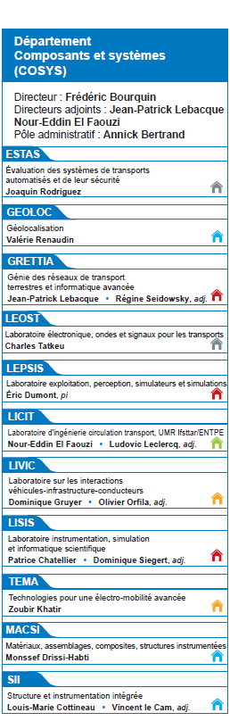
GRETTIA
Engineering of Surface Transportation networks and Advanced Computing Laboratory.
2 research themes:
  Modelling and multimodality
  Data and mobility

Slide 4






Data and mobility: Identity
Mobility
analysis
Quality and
reliability of transport systems
Keywords: urban mobility, diagnosis, maintenance, reliability, digital traces, mass data, data sciences, ergonomics, user behaviour
Areas of expertise:
  Mainly public transport and active modes, shared mobility
  Interdisciplinary vision: data mining and humanities and social sciences

Slide 5
Overview
Ergonomics: Definition and domains
French ergonomics
  Analysis of work
  Distinction task/activity
  Determinants of the activity and crucial role of the context
  Methodologies
  From work to everyday life
Applications
  SYSMO
  MIC
  Karos

Slide 6
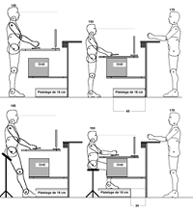

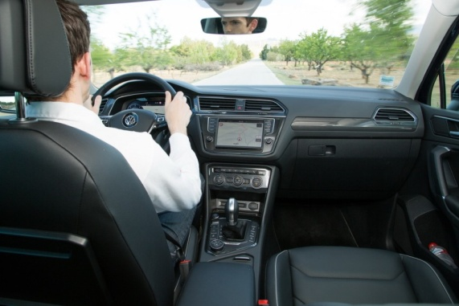
Ergonomics: Definitions
The beginnings (1969): “Ergonomics is the scientific discipline concerned with the understanding of interactions among human and the work means, methods and places.”
Nowadays (2000): “Ergonomics or human factors is the scientific discipline concerned with the understanding of interactions among humans and other elements of a system, [...] in order to optimise human well-being and overall system performance.”

Slide 7
Ergonomics:
Domains of specialisation
Physical Ergonomics: human anatomical, anthropometric, physiological and biomechanical characteristics.
Cognitive Ergonomics: mental processes.
Organisational Ergonomics: optimisation of sociotechnical systems.

Slide 8
French Ergonomics: A history
Just before and after World War II: Analysis of work
  ‘L’analyse du travail’ (Ombredane and Faverge 1955)
  Leplat and Wisner: formalisation of concepts for more than 40 years.

Slide 9
French Ergonomics:
Core concepts
1975: The need to distinguish what needs to be done, the goal (tasks) and what workers really do to do this task (activity).
  Importance of
    Analysing the real behaviour of operators.
    Understanding how the activity is constructed by a given operator in a given context.
  The operator is not only the ‘human factor’ but a ‘human actor’ (Weill-Fassina et al. 1993).
  For one task, they are a lot of different activities.
Task
Goal that is set
Conditions in which it should be achieved
Activity
What is undertaken by the subject to accomplish the task

Slide 10
French Ergonomics:
Core concepts
Why this difference between prescriptions and real work?
  It is impossible to prescribe all details of the work.
  Operator deals with variability and diversity.
  Operator is not able to precisely represent a work with an imprecise definition.
  Operator has his own objectives, constraints and values.

Slide 11
French Ergonomics:
The determinants
Determinants of activity
  Characteristics of the operator (sex, age, socio-professional category, physiology, psychology, experience, knowledge, representations...)
  Context at different levels (society, culture, organisations, tools, technologies, spaces, rules, other humans and interactions...)

Slide 12
    French Ergonomics: the role of the context
Activity theory: “Actions are always situated in a context and are impossible to understand without that context.” (Kuutti, 1996).
Context is a very ill-defined concept.
  Situation, field, milieu, background, environment...
  The context has an opportunistic nature and its role is partially unconscious for the operator.
  It offers resources and integrates constraints.
  It is complex, not closed or limited.
Neighbouring approaches
  Situated action (Suchman, 1987): Human action is constantly constructed and reconstructed from dynamic interactions with the material and social worlds. Environment is an integral part of the cognitive process.
  Distributed cognition (Hutchins, 1995): Cognition is distributed within the sociotechnical system.

Slide 13
French Ergonomics: Methods
Techniques have been developed mostly for field analysis:
  Observation
  Interviews
  Verbalisations
  Autoconfrontation
  Surveys and logbooks
  Simulations

Slide 14
French Ergonomics today
Not limited to study work
  Human-machine interaction
  Everyday life conception
  User involvement in conception
  Service relations
  Innovation
    Prospective ergonomics
Cognitive, social and affective dimensions

Slide 15
Applications
Sysmo 2015
  Developing sustainable mobility outside urban centers (multimodal traveller information, shared mobility)
MIC (2013-2016), IRT SystemX
  Understanding and modelling passengers’ behaviour in disturbed situations
Karos (2016-2017)
  Understanding users and usages of an application of smart ridesharing to improve it

Slide 16
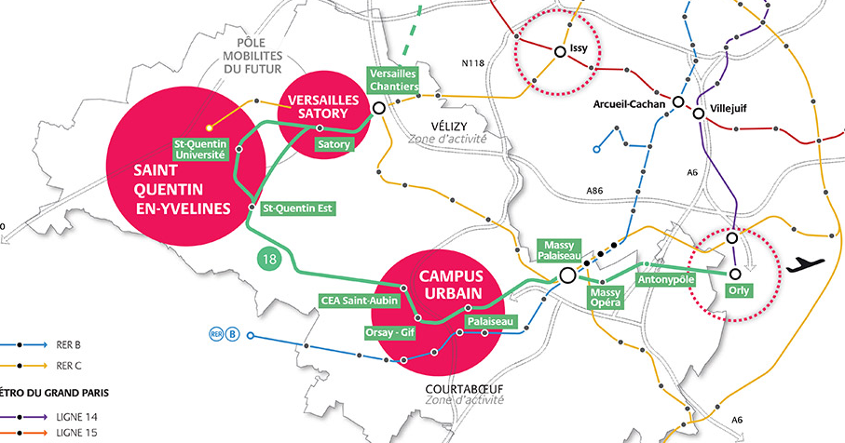
SYSMO -1-
A set of experiments on innovative mobility services grouped together in a systemic and dynamic approach:
  Multimodal travel information platform,
  Shared mobility services (Dynamic ridesharing, community car sharing),
  Car parks with high level of service,
  Simulation of transport flows to local policy makers (decision support tool).

Slide 17
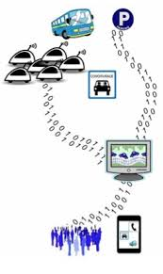
SYSMO -2-
First question: What is the real activity of people moving through the territory?
Second question: How could the new services proposed match with this reality?
In-depth interviews with area users.

Slide 18
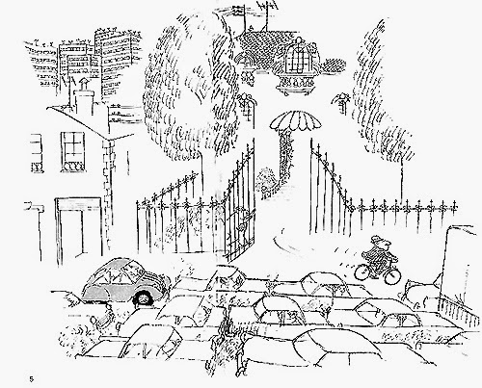
SYSMO -3-
Main results:
  Commuters are real strategists.
  Companies greatly influence mobility.
  Mobility is not only an individual question.
  Moving is also doing other things.

Slide 19
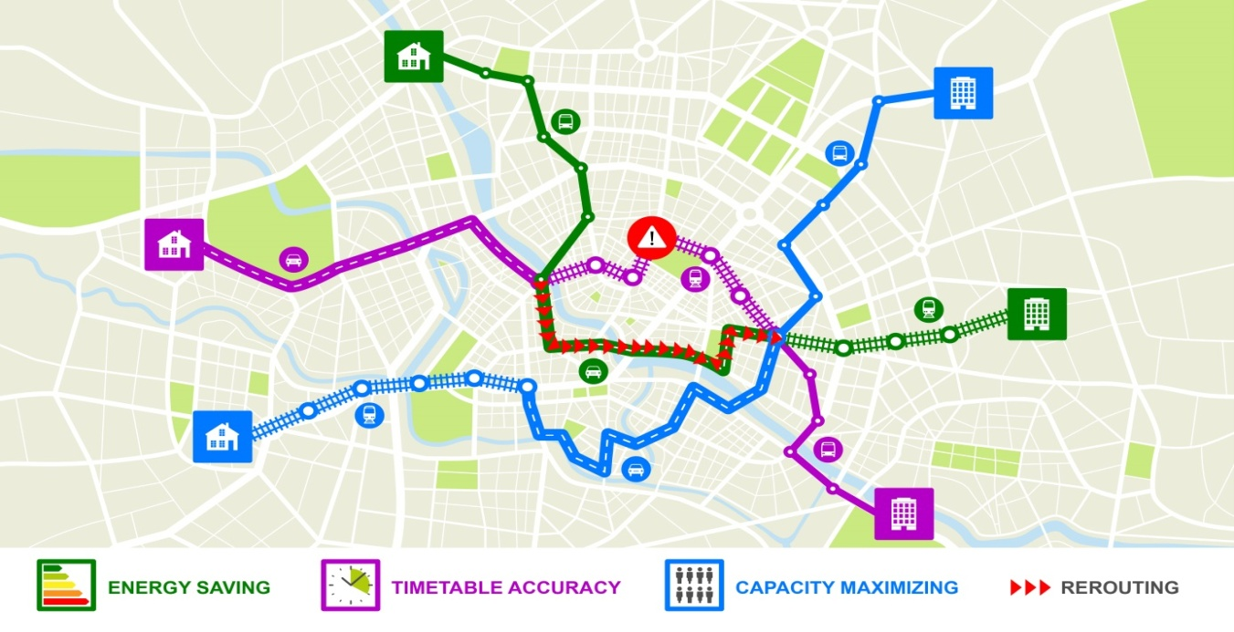
MIC -1-
Disturbances
Transport model
Simulation of the multimodal transport system, including its passengers
Behavioural approach
Multi-agent model

Slide 20
MIC -2-
Behaviour
Person
Personality (coping with uncertainty)
Experience
Situation
Business vs. leisure trip
Information
Disruption
Time
Informational content
Reliability
Rush-hour vs. off-peak
Habits
Attitude
Weather
Socio-demographic characteristics
Delay
Type of incident
Travel purpose
Outbound or inbound trip
Source
Preferences

Slide 21



MIC -3-
Semi structured interviews
Exploring the domain
Preparing the survey
28 users:
- 4 tourists
- 4 casual users
- 20 daily users
Survey 1 (single)
Identifying the characteristics of the respondent and his/her mobility pattern
470 users: almost representative sample on
- sex
- socio-professional category
- age
15-day logbook
Understanding behaviour in real situations
100 daily users out of the 470
195 questionnaires completed following disruptions of different delay levels (representative of the survey period)
Survey 2 (repeated)

Slide 22
MIC -4-
Main results: relationship between behaviour and
  Expected waiting time: decision threshold at thirty minutes.
  The time when the user receives information.
  The accessible public transport solutions at the time of choice-making.
  Time pressure.
  The type of disturbance.

Slide 23
KAROS -1-
Partnership with a start-up proposing smart ridesharing
  Learning spatiotemporal mobility patterns
  Smart matching
  Automation of the research
Some questions about usages and users to improve the service

Slide 24
KAROS -2-
Combination of methods:
  State-of-the-art research on shared mobility, habit changes, incentives, smart systems in different domains (home “Nest smart thermostat”, work, mobility)
  Analyses of existing data: market team calls, use traces (IM conversations and opportunity refusal)
  In-depth “interviews of explicitation” to understand the actual experience of ridesharing

Slide 25
KAROS -3-
Main results:
  Bad experiences with Nest
  Different possible improvements:
    Information processing
    Human-system interaction to build trust
    Human-human interaction to facilitate relationships in an unknown context
    Better use of past user experience to personalise future experience

Slide 26
Conclusion
Contributions of French Ergonomics to the design of mobility systems:
  A systemic understanding
  Field study methods
  A theoretical background based on the distinction between task (designer point of view) and activity (user point of view)

